Slide 1
Math Statistics
By Annabelle, Sashana & kat

Slide 2
Music
We are studying what is the most preferred way to listen to music, how many hours in a typical day people listen to music and if you find it helpful to listen to music while studying or not.
It is useful to have these opinions because radio stations will know what songs to play on the radio.
We collected this information by a survey sent to all the year nine in all saints.
The survey was a convenience sample because it was only surveying the year 9s at this school.

Slide 3
What is the most preferred way to listen to music?

Slide 4
bias
Bias: because it assumes that peaple like to listen to music
not bias: because it allows peaple to enter in their own response if non of the above suited their response.

Slide 5
Mode: Spotify

Slide 6
Median: Spotify

Slide 7
Notes:
catagorical

Slide 8
For how many hours in a typical week do u listen to music?

Slide 9
Bias
Bias: because it assumes peaple listen to music

Slide 10
Mean: 2.08

Slide 11
Mode: 1

Slide 12
Median: 2

Slide 13
Quartiles: 1

Slide 14
Range: 18

Slide 15
Interquartile range: 3

Slide 16
Outliers: 30, 40 & 48

Slide 17
For how many hours in a typical week do u listen to music?
Notes:
Numerical

Slide 18
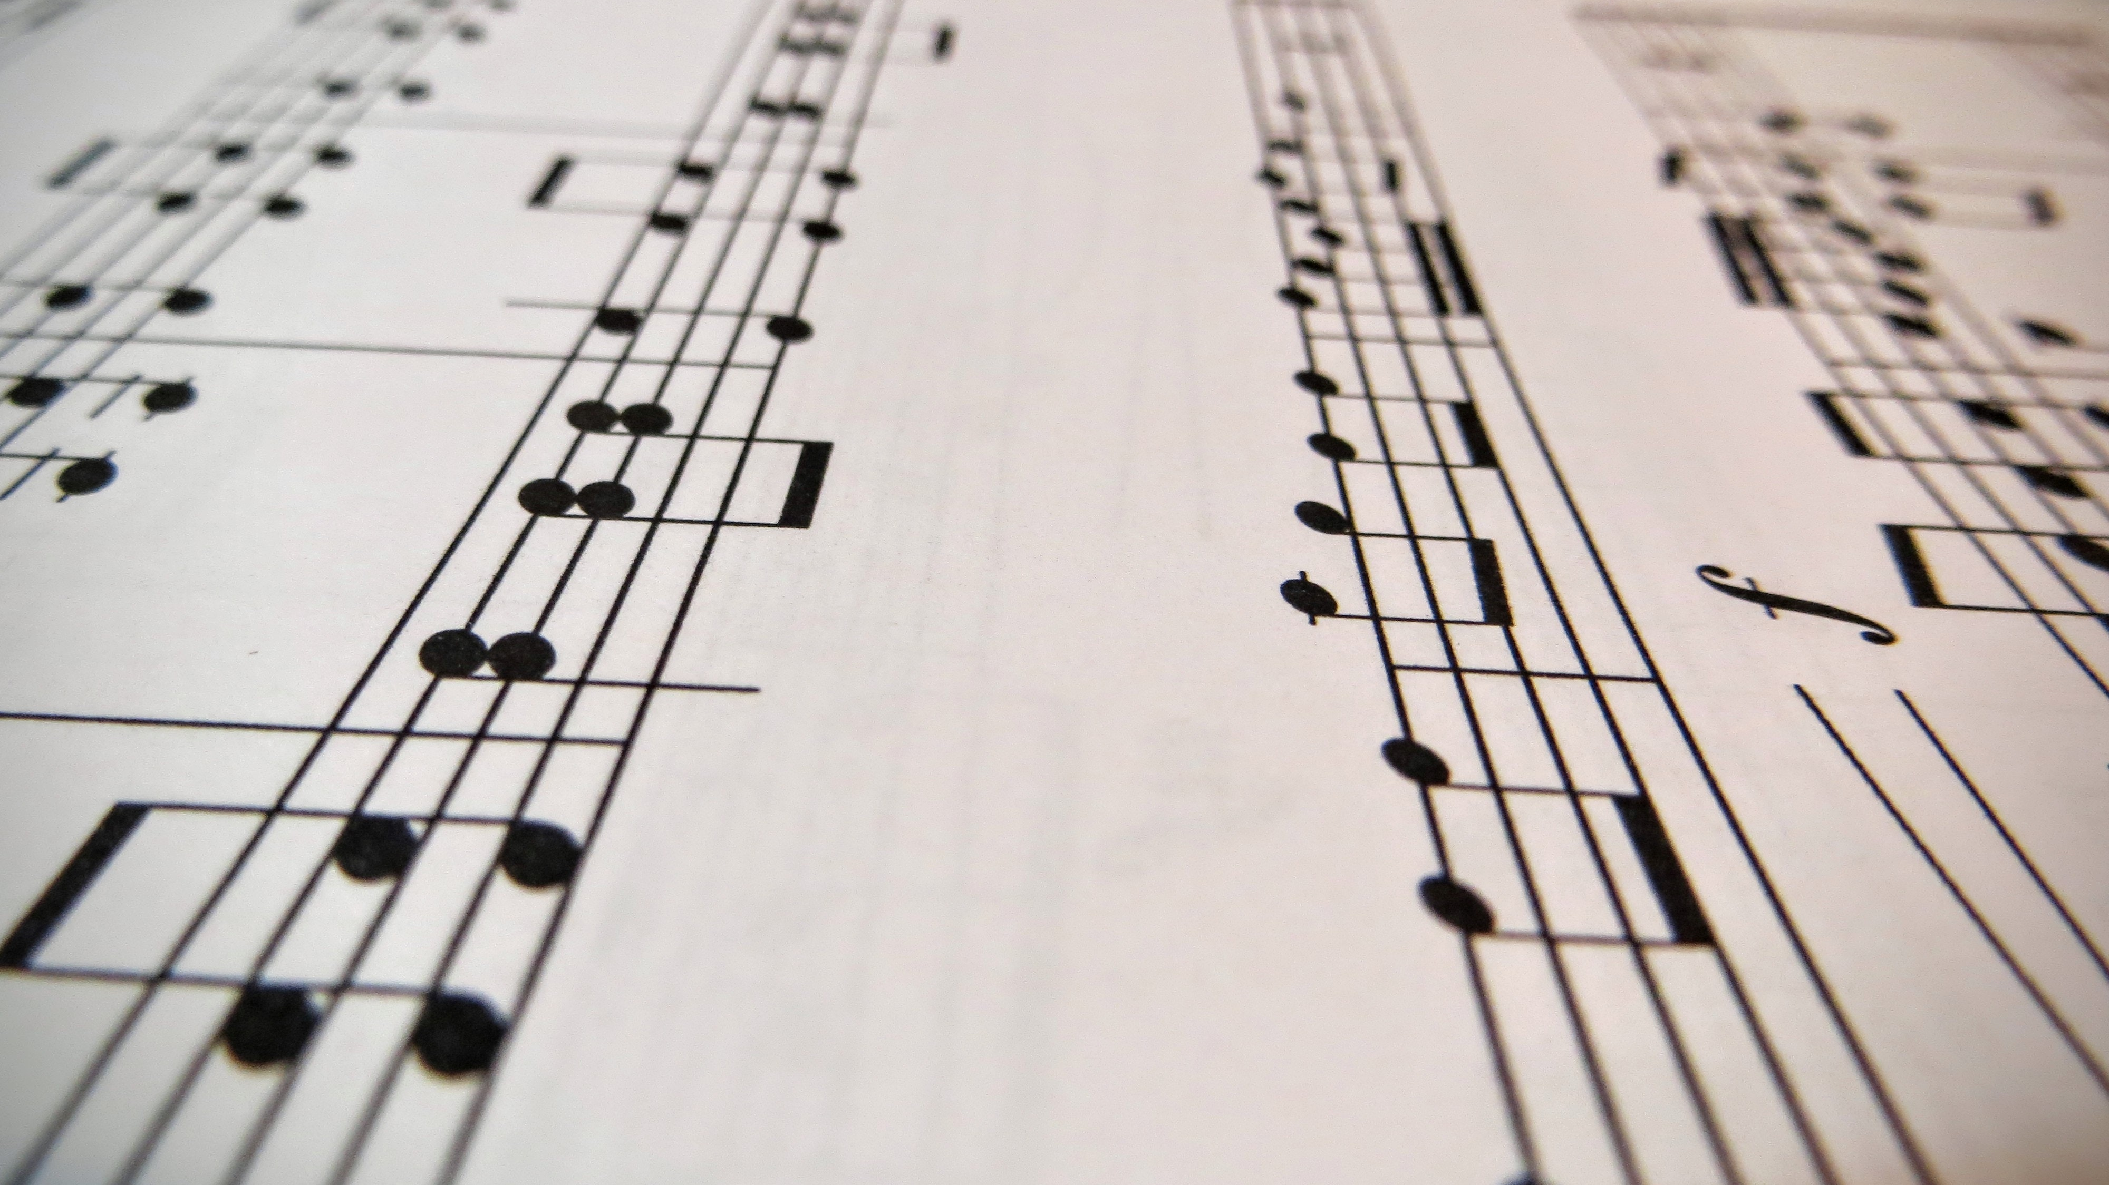
Do you find it helpful to listen to music while studying?

Slide 19
Mode: Always

Slide 20
Median: Always & Sometimes

Slide 21
Notes:
Catagorical

Slide 22
Shape of the distribution
77% of peaple chose Spotify.
We are not surprised by these results because Spotify is the goto way to listen to music becuse it easy to use and you don’t have to pay for it.
This is skewed to the left
The mean is 2.08
The median is 2
We would expect this because it is skewed to the left
Is this skewed to the right

Slide 23
Any Unexpected or Surprising Results?
The only surprising / unexpected results where some people had put 30, 40, 48 for the number of hours they listen to music in a day. Which isn’t possible because there is only 24 hours in a day.

Slide 24
Any Potential Explanation for your Results?
Some potential explanation for our results that you can see in the data is that most of the graphs are skewed?

Slide 25
Highlight limitations with your work
Our limitations were people not making an accurate guess to how many hours they listen to music a day which affected the data. We could have asked a bigger variety for of different ages kids for the servay.

Slide 26
Make recommendations for future research in this area
Start putting your data into your end product like a powerepoint from the beginning of the project not art way through
Make multipole different types of graphs for each set of data

Slide 27
Comment on your experience of the task
We learnt a lot about people's interest in listening to music and how many people think it improves their learning.

