Slide 1
Statistics
By Callum Cleave and Ayush Atre

Slide 2
What are we studying?
We are studying how many hours all saints' students put into Wellbeing and mental health per week.

Slide 3
How we Researched
We researched this impeccable topic and found the key points we needed from an excel spreadsheet that surveyed each one of the students in year 9 and calculated how many hours each one does a week for their mental health
We then converted this into a bar graph

Slide 4
Our Numerical Data
Outliers: 999 and 50
Mode: 0
Median: 4
Mean: 30.41
Quartiles: 1
Range: 21
Interquartile range: 2

Slide 5
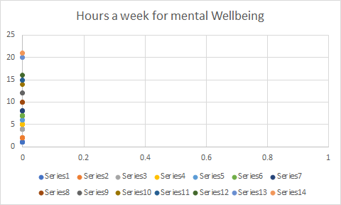
Graphs- Numerical Data

Slide 6
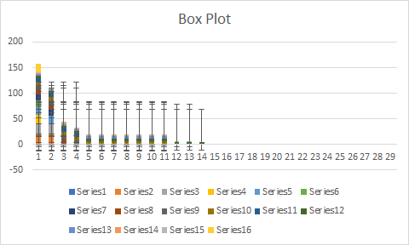
Box Plot
Here is our box plot to represent our data

Slide 7
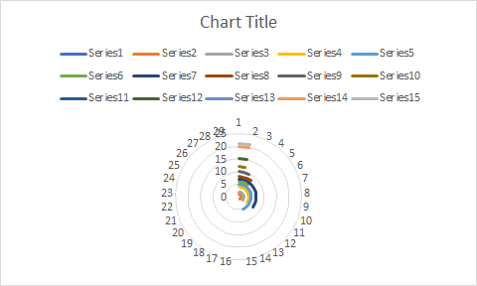
Other ways to show our numerical data

Slide 8
Interesting points
The data which we analysed the results from 14 people. The Data wasn’t skewed and was uni-modal. This outcome was found after we had removed the outliers (50, 999).
999 was obviously someone having fun as there is only 168 hours in a week.
A bit of data I found interesting was that with hours: 2, 4 and 7. They all had exactly 11 people who chose them. I am not sure why this is but it is an interesting coincidence to say the least.

Slide 9
Why did people answer the way they did?
The mode in this set of data was “0”. Meaning the majority of students spend “0” hours on physical and mental wellbeing. This option was choen by exactly 29 students. We believe that ALL of these students are unaware of the activities that fall under wellbeing. This is why most of them thought that they do none at all.
Wellbeing activities can range from going to a different country to simply taking the time to enjoy the air outside.

Slide 10
Limitations?
The largest issue with our topic is the fact that “Wellbeing” is a very broad ‘umbrella’ Term for our topic. Similarly to our Reasoning to why the students answered this way, Most of the students don’t have a solid definition of what kinds of activites fall under wellbeing. This means that most of our data is probably incorrect.

Slide 11
What’s in our future?
In the future if this topic is chosen again. They should have two different areas that are labelled “Mental” and “Physical” Wellbeing. So we can further break down the issue. Despite the fact that this doesn’t completely solve this problem it does take the first step into refining this data set.

Slide 12
Our comment
Ayush
Callum
I thought that our effort was very solid. Callum and I both separated tasks for each of us to complete. We also did work in our own time to help each other out.
I believe that we did an impeccable job, and our work was very noble, and I believe the statistics taught you a lot of interesting knowledge that we have gained along this project
Thank you

Slide 13
Thank you for reading!
We sincerely hope that all of this data didn’t bore you with all of this data. Hopefully you learnt some interesting statistics on how our classroom operates in their own time to take care of themselves!

