Slide 1
Pets
Josh C, Dylan B, Jack M
Notes:
All

Slide 2
Introduction
We decided to examine the subject of how many pets people in school had.
As a group we were talking about pets and animals; two members of our group had pets and the other member didn’t have a pet. The member who didn’t have a pet said more of the year group wouldn’t have a pet, but the other two members said that most of the year group would have a pet.
We decided to carry out research to answer this question.

Slide 3
Hypothesis and Outcomes
Our main hypothesis was that more children at our school have pets than don’t.
Our primary outcome was to determine if more children at school had pets than didn’t.
As a secondary outcomes we wanted to know
How many pets people have?
What type of pets they have?

Slide 4
Methodology
Notes:
All

Slide 5
Method
We felt the most appropriate method to use was quantitative rather than qualitative. This way we would have numerical data to examine
We determined the best research instrument for this would be an anonymized survey
We decided to sample the year nine students
This was a non-randomized convenience cluster sample
The survey was distributed to all year 9 pupils (142)
There was a low non-response rate

Slide 6
Bias
The main form of bias is probably in the form of sampling bias.
It was a non-randomized convenience sample which had the advantage that it was easy to administer and obtain a very high response rate, but sampling bias could be significant.
It was only year 9 students and they all go to All Saints. This is a very specific group and different results could be obtained from a more rural school that might have more pets or even a different year group in All Saints
We also noted the survey only gave the option of certain pets and so the survey tool itself was flawed.
The sample size may have been too small to draw inference from for the whole school population.

Slide 7
Bias Reduction
We anonymized the survey to ensure people could fill it in without feeling bad for not having a pet or for having too many.
The participants filled out the survey individually and not in groups to avoid peer influence.
Although the survey size was not large, we tried to capture as many responses as we could given our available resource

Slide 8
Validity and Reliability
In terms of validity the survey tool measures what we set out to establish; the number of pets that people have in the school. However, the specific nature of the sample and the bias introduced may mean that the information is not generalizable to the school population.
The reliability of this tool is not established. We would need to use the survey again in a test and retest model to confirm reliability. As an alternative we could use a different method of information gathering such as a questionnaire to test how reliable the survey tool is.

Slide 9
Results
Notes:
All

Slide 10
Categorical Pie and Stacked bar chart

Slide 11
Categorical data Histogram

Slide 12
Numerical box plot
This is a box plot of how many pets people have. This box plot is mainly concentrated in one place because most people only have one or two pets. The dots represent people who have got more pets but because there isn’t enough of the people who also had the same amount of pets, they aren’t included in the main body of the box plot.

Slide 13
Numerical Bar chart
This graph is positively skewed because the right tail of it is elongated more than the left tail.
Notes:
Dylan + Josh

Slide 14
Numerical
Turquoise = outliers
Blue = non-outliers

Slide 15
Further investigation on how many pets you have based on your gender
In this set of box plots we can clearly see that females own more pets because their interquartile range is higher than the males interquartile range. Most of the females who participated in this survey had pets. Whereas the more of the males who participated didn’t have any pets.
Note:
There was only 3 ‘Non-Binary’ people so the average of that data set is not accurate against the male and female sets.

Slide 16
Analysis
Notes:
All

Slide 17
Categorical
The Mode of the categorical data was clearly dogs with 41% of respondents having one.
Cats were next with 16% followed by fish.
In answer to the original question posed only 15% of people did not have a pet. Therefor the hypothesis was supported.
Of note ‘none of the above’ could either mean that you did not have a pet or that you didn’t have one of the pets listed. This could lead to inaccuracy of our results.

Slide 18
Numerical
The mean for the numerical data is 2.297872. (rounded down to 2)
The median for the numerical data is 1. This is because most people only have between 1 and 3 pets.
The mode for the numerical data is1.
The lower quartile is 1, the 2nd quartile is 1 and the upper quartile is 2.
The range for this data is 39
The interquartile range (IQR) is 1.

Slide 19
Numerical
There were many outliers in our data. Our data shows that 15% of people who owned pets were outliers. This was 21 people altogether. To be an outlier you had to have more than 3.5 pets and less than -0.5 pets. This is impossible to get so we only used the upper band to calculate who was an outlier.
Both the box plot and the bar chart show a skewed pattern of distribution.
Large numbers of extreme outliers pull the mean up, which makes the mode and median values more reliable.
An interquartile range of 1 but a full range of 39 is unusual and once again points to an atypical data distribution. It is important in these circumstances that we are careful what inferences we draw from the data.
The bar chart demonstrates positive skewing and the box plot has a very narrow plot with significant outliers

Slide 20
Discussion
Notes:
All

Slide 21
Hypothesis and outcomes
Our primary hypothesis that more children at school have pets than don’t, this seems to be supported by the available data.
Secondary outcomes showed that the majority of people have dogs and most people have one pet. This was surprising because we thought most people would have 2 pets.
It was also noted that the data was positively skewed with significant outliers. One person recorded 39 pets. But most only had one.
We must be cautious when deriving outcomes from unusual data patterns

Slide 22
Limitations
We identified possible bias in the way the sampling was designed. This could have introduced bias
The small sample size may be a problem for generalizability to the wider population
The group of people sampled was not random so bias could be introduced
The survey tool was flawed as some pets were excluded and will cause inaccuracies in results.
The results of the data were unusual and so other statistical processes may have been more appropriate

Slide 23
recommendations
A larger sample size would improve generalizability
A randomized sample which was not convenience or clustered would allow better inference to the wider population
The survey tool was identified as having a flaw, as it limited the number of pets that could be chosen. This would be changed next time.
We could use a different methodology such as questionnaires or interviews to demonstrate the reliability of the survey tool.
A subgroup analysis based on age of pupil or sex could be carried out to compare the two groups
Given the non-normal distribution of the data we could consider other statistical methods of analysis.

Slide 24
Comment
This task was very challenging yet fun to complete. There were many outliers in our results, so finding them was hard. Finding equal contribution in the group’s work was also hard since different jobs varied in difficulty quite a bit. In the future, I think we should have communicated better within our group because this would have allowed us to distribute the work more evenly, without someone having to do it all. Since the data we had received was only from year nines at All Saints college this didn’t allow us to make an accurate estimate on how many people had pets in school. This presented a challenge for us to try and acquire the data we needed. All of us agree that next time we do a statistics project we need to research the topic a bit more before we start and we need to make a plan before we start as well.

Slide 25
Conclusion
Notes:
All

Slide 26
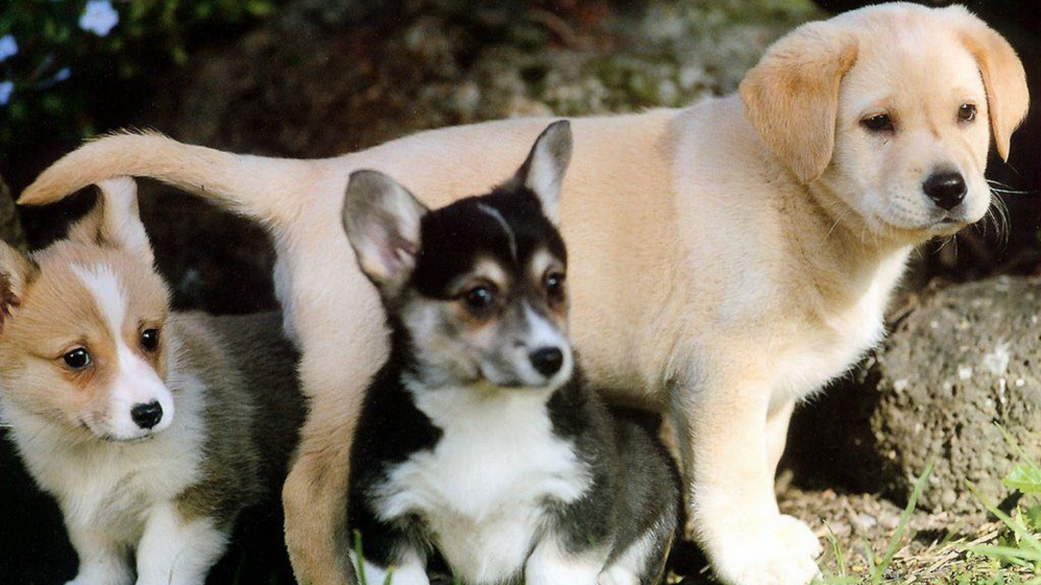
Conclusion
In conclusion our hypothesis was supported in the end. Most of the people in year 9 had some sort of pet in their household. In our survey it was around 85% of people who owned a pet. This supported our hypothese but we were surprised because we thought that it would be a 60% to 40% split. Another thing we found out was that most of the people had dogs and the second most popular pet was cats. Our group found it very interesting to see what our peers pets were and how many pets people had in a household.

