Slide 1
SURVEY RESPONSES
QUINN AND HOLLY

Slide 2
WHAT ARE WE STUDYING?
We are analyzing survey responses of Year 9s and ASC on how many servings of vegetables they eat on a typical day and what their favorite food is.

Slide 3
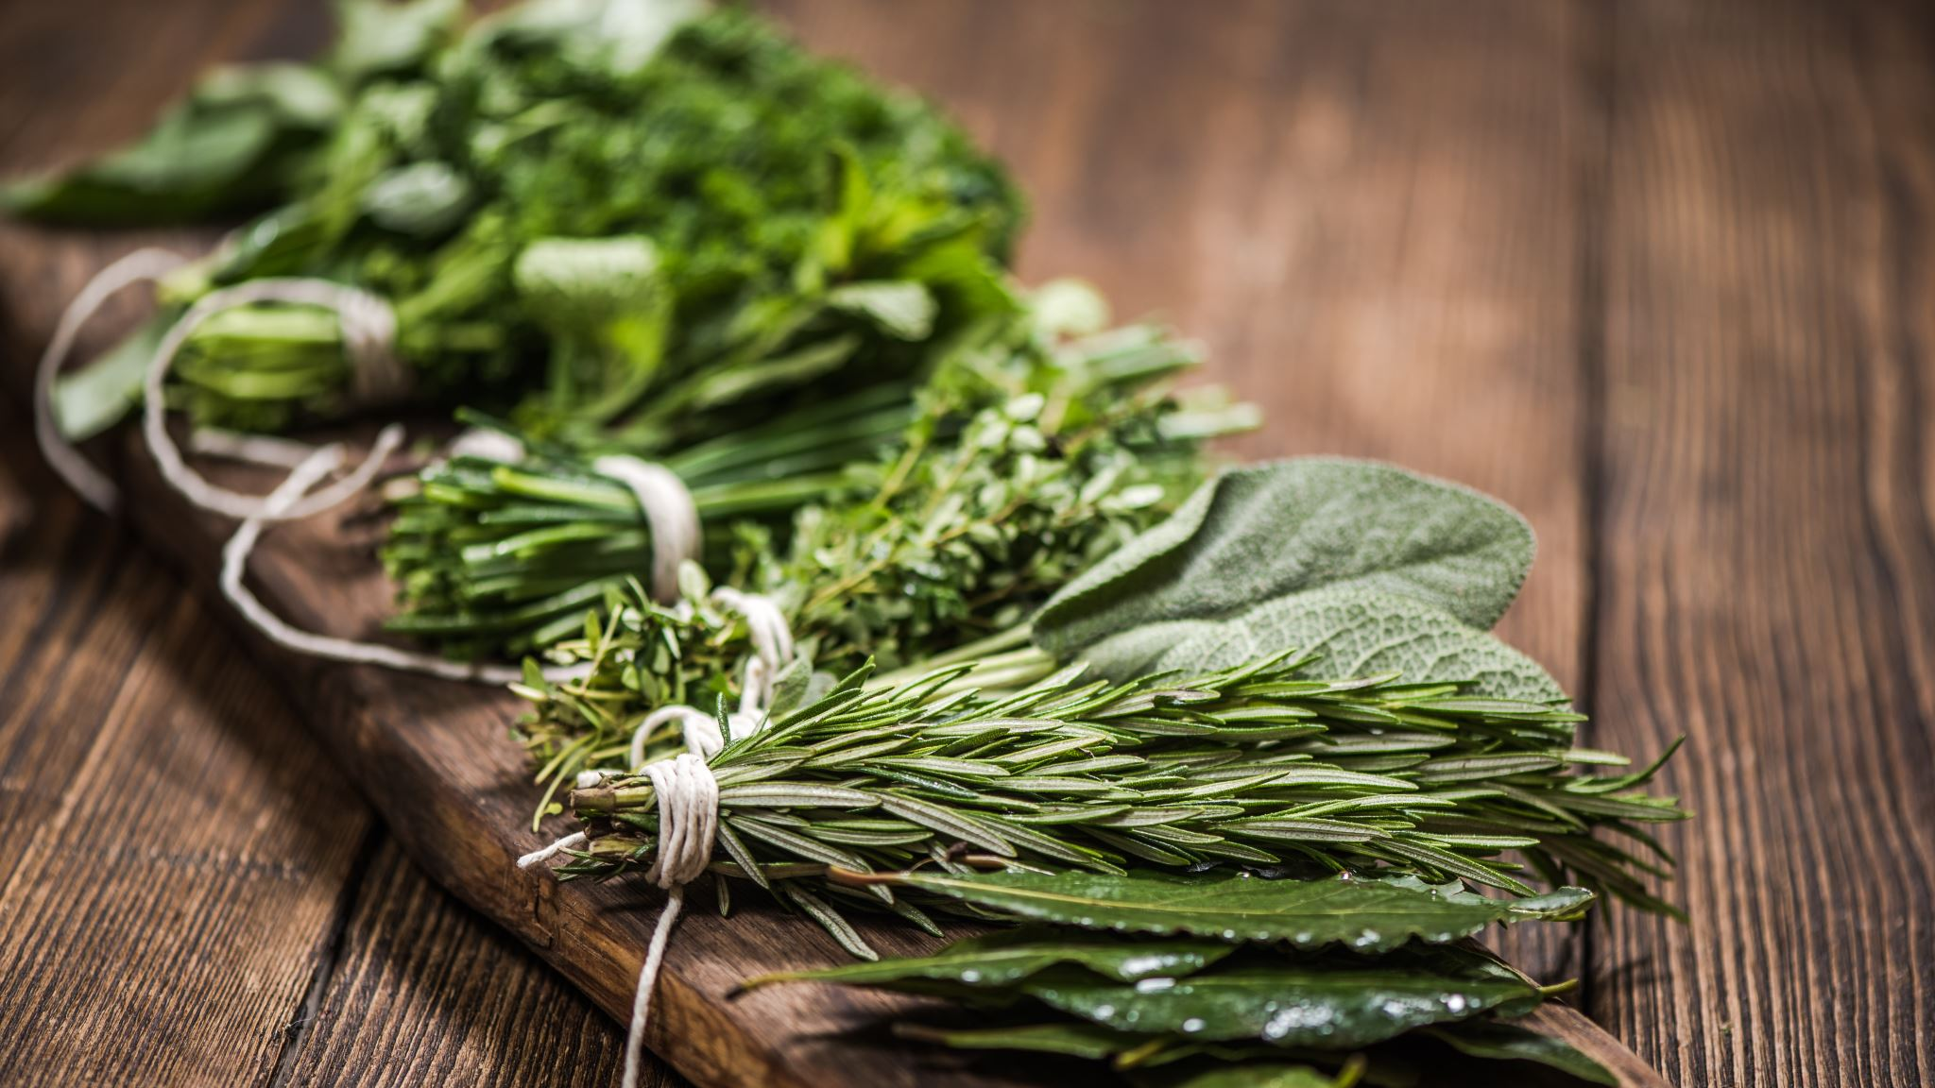
WHAT DID WE DO?
WE DECIDED TO TAKE ON THE TOPIC OF FOOD AND NUTRITION. THIS IS CONTSANTLY CHANGING THROUGHOUT HISTORY DUE TO THE CHANGE OF DIET AVALIABLE AND ECUCATION ON THE TOPIC AS WELL AS AWARENESS. WE WILL BE RESEARCHING AND ANALYZING THE AVERAGE YEAR 9 STUDENTS FAVOURITE FOODS AND THEIR INTAKE OF VEGETABLES DAILY.

Slide 4
OUR RATIONAL
THIS TOPIC WILL SHOW THR CONSUMPTION RATE OF VEGETABLES, AND MAY INFLUENCE THE CANTEEN AND VENDING MACHINE TO CHANGE THE FOOD THEY OFFER TO STUDENTS AND STAFF. THE RESULTS WILL BE VERY INTERESTING TO SEE WHAT GENDER ACTUALLY TAKES THE INITIATIVE TO MAKE SURE THEY ARE GETTING THEIR 5 SERVES OF VEGETABLES A DAY AND MAINTAINING A HEALTHY DIET. WE SUSPECT THAT VERY FEW PEOPLE ACTUALLY DO.

Slide 5
SAMPLING AND BIAS
WHEN CONDUCTING THIS SURVEY, THE HOST (MS. MAST) CHOOSE TO SAMPLING THE ENTIRE POPULATION NEEDED FOR THIS EXPERIMENT. THIS PROVIDES ACCURACY AS THERE IS NO CHANCE OF IMPROPER CONCULSIONS BUT ALSO MAKES IT COSTLY AND TIME CONSUMING, ESPECIALLY IN THIS SURVEY.

Slide 6
GENERALISATIONS
SINCE WE ONLY DID THIS SURVEY ON THE YEAR 9’S AT ASC AS OF 2021, IT WOULD NOT BE ACCURATE TO SAY THAT THIS IS A PROPER EXAMPLE OF HIGHSCHOOLERS OR PEOPLE OF ALL AGES. NEITHER CAN YOU MAKE GENERALISATIONS ABOUT PEOPLE OUTSIDE OF THE SURVEYED AS THEY HAVENT SHARED THEIR OPINIONS. IF WE WERE TO TEST THE ENTIRE UPPER SCHOOL THEN WE COULD PROBABLY MAKE GENERALISATIONS ABOUT ASC HIGH SCHOOLERS.

Slide 7
WHAT BIAS DID WE HAVE?
IN THIS SURVEY WE HAD RESPONSE BIAS AS THIS SURVEY WAS QUITE LENGTHY SO WE CAN DEDUCE THAT AT LEAST A FEW PARTICPANTS WERE PROBABLY TIRED/BORED, COMING TOWARDS THE END OF THE SURVEY. WE MOST PROBABLY HAD SOCAIL DESIRABILITY BIAS AND ‘YES MAN ‘ BIAS AS THE PARTICIPENTS MAY HAVE FELT INCLINED TO CHOOSE THE SOCIALLY ACCEPTABLE ANSWER LIKE ON THE NUMBER OF SERVES THEY HAVE A DAY.

Slide 8
HOW DID WE AVOID BIAS?
WE AVOIDED BIAS BY RANDOMIZING THE ORDER OF QUESTIONS IN THE SURVEY SO THE CHANCE OF HAVING QUESTION ORDER BIAS WAS REDUCED SIGNIFICANTLY. WE ALSO TRIED OUR BEST TO AVOID SOCIAL DESIRABILITY BIAS BY NOT SHOWING WHO PUT DOWN WHAT ANSWER, BUT ONLY PUTTING DOWN THEIR CHOOSEN GENDER. OTHER THEN THAT WE BELIEVE THAT THE SURVEY DID A PRETTY GOOD JOB, AS IT WOULD BE NEAR IMPOSSIBLE TO COMPLETELY AVOID BIAS.

Slide 9
WHOLE NUMERICAL DATA
LOWER QUARTILE | MEDIAM | UPPER QUARTILE | MEAN | MIN | MAX | RANGE | MODE
2 | 3 | 4 | 3.3 | 0 | 15 | 15 | 2

Slide 10
INTER QUARTILE RANGES
LOWER QUARTILE | UPPER QUARTILE
3 | 12

Slide 11
SUBGROUP NUMERICAL DATA
GENDER | LOWER QUARTILE | MEDIAN | UPPER QUARTILE | MEAN | MIN | MAX | MODE | RANGE
FEMALE | 2 | 3 | 4 | 3.3 | 0 | 9 | 2 | 7
MALE | 2 | 3 | 4 | 3.5 | 0 | 15 | 2 | 15
NON-BINARY | 1 | 1 | 1.5 | 1.3(RECURRING) | 1 | 2 | 1 | 2

Slide 12
INTER QUARTILE RANGES
GENDER | LOWER QUARTILE | UPPER QUARTILE
FEMALE | 3 | 6
MALE | 3 | 12
NON-BINARY | 1 | 2

Slide 16
FROM THIS DATA:
FROM THIS DATA WE CAN TELL THAT MALES AND FEMALES IN YEAR 9 (AT ASC) ON A TYPICAL DAY HAVE APPROXIMENTLY 2 SERVES OF VEGETABLES. WHILE NON-BINARY STUDENTS TYPICALLY HAD 1. WE ARE ABLE TO SEE THIS THROUGH THE MODE. THROUGHT THIS WE ARE ABLE TO DEDUCE THAT THIS DATA IS UNIMODEL AND TENDS TOWARDS SYMMETRICAL, WITH THE PEAK BEING AT 2. THE NEXT 2 POPULAR OPTION WAS 3 AND 4, SHOWING THAT MAJORITY OF THE YEAR 9 STUDENTS ARE PRETTY HEALTHY BUT ARE NOT GETTING THE RECCOMENDED 5 SERVES OF VEGETABLES A DAY.

Slide 17
WHAT CAN WE LEARN FROM THE NUMERICAL DATA?
WE ARE ABLE TO LEARN AND SEE THAT MALES GENERALLY HAVE A BIGGER AMOUNTS OF SERVINGS OF VEGETABLES THEN FEMALES AS THEIR DATA IS MORE LEFT SKEWED WHILE FEMALES ARE MORE LIKELY TO HAVE LESS SERVINGS OF VEGETABLES (WE CAN SEE THIS THROUGH THE FEMALE DATA BEING RIGHT SKEWED). IT IS HARD TO MAKE CONCLUSIONS BASED OFF OF THE NON-BINARY DATA BECAUSE THERE IS SO LITTLE BUT WE ARE ABLE TO TELL THAT THEY DON’T MAKE THE HEALTHIEST DECISIONS WHEN IT COMES TO THEIR EATING HABITS.

Slide 18
OUTLIERS (NUMERICAL)
IN OUR NUMERICAL DATA WE HAD SOME OUTLIERS WHICH WE CHOOSE TO INCLUDE IN OUR GRAPHS AND STATISTICS. IN OUR DATA WE HAD WHAT WE BELIEVE TO BE SOME RESPONSE BIAS WHICH WE BELIEVE TO HAVE CAUSE THESE OUTLIERS. THIS INFLUENCED THE DATA TO HAVE A BIGGER RANGE AND A HIGHER UPPER QUARTILE AS THE OUTLIERS WERE ON THAT END OF THE DATA. THE OUTLIERS INCLUDED:
ANYONE WHO SAID THEY NORMAL HAD:
- 8-10 SERVINGS
-12 SERVINGS
-OR 15 SERVINGS
THE OUTLIERS COVERED 5% OF OUR TOTAL DATA, WHICH WE THEN INCLUDED IN OUR GRAPHS AND STATISTICS (MEAN, MODE, MEADIAN, RANGE, ETC)

Slide 19
CATAGORICAL DATA
2-minute noodles = 0.8%
Apple pie = 1.8%
Avocado = 0.8%
Bacon and Eggs = 0.8%
Burger = 5.9%
Burritos = 0.8%
Carbonara = 1.7%
Chicken = 7.5%
Chips = 1.7%
Kloß mit Soß = 0.8%
Mango = 2.5%
Marshmallows = 0.8%
Popcorn = 0.8%
Chocolate = 1.7%
Crayfish = 0.8%
Croissant = 0.8%
Curry = 1.7%
Donuts = 1.7%
Enchiladas = 0.8%
Fish and Chips = 0.8%
Fried rice = 1.7%
Potato = 0.8%
Greek souvlaki = 0.8%
Green apple = 0.8%
Himalayan Gerkan = 0.8%
Hot chips = 2.55
Ice cream = 3.3%
Lasagna = 4.2%
Maccas = 0.8%
Nachos = 2.5%
Noodles = 1.7%
Oreos = 0.8%
Passionfruit = 0.8%
Pasta = 16.9%
Pineapple = 0.8%
Pizza = 5.9%
Pomegranates = 0.8%
Raspberries = 0.8%
Ribs = 0.8%
Rice = 3.4%
Rice cakes = 0.8%
Salmon = 1.7%
Steak = 1.7%
Sushi = 4.2%
Tacos = 2.5%
Wagyu beef = 0.8%

Slide 21
STATISTICS
MODE IS PASTA WITH THE MOST VOTES
WE HAD A NUMBER OF OPTIONS WITH THE SAME AMOUTNS OF VOTES WHICH LEADS US WITH A MULTITUDE OF OPTIONS FOR THE FOOD WITH THE LEAST NUMBER OF VOTES. THIS INCLUDES BUT IS NOT LIMITED TOO:
APPLE PIES
AVOCADOS
BURRITOS
CROISSANTS
AND OREOS

Slide 22
FROM THIS GRAPH:
FROM THIS GRAPH WE ARE ABLE TO TELL THAT THE DATA IS UNIMODEL WITH THE PEAK ON PASTA. WE ARE ABLE TO TELL THAT MORE PEOPLE ENJOY PASTA THEN ANYTHING ELSE THROUGH THE MODE. WE ARE ALSO ABLE TO TELL THAT FEMALES ARE MORE LIKELY TO PICK THE SWEETER FOODS WHILE MALES ARE MORE LIKELY TO PICK SAVOURY FOODS.

Slide 23
WHAT CAN WE LEARN FROM THE CATAGORICAL DATA?
WE ARE ABLE TO LEARN AND SEE THAT MAJORITY OF THE SUDENTS MAKE HEALTHIER DECISIONS WITH THEIR MEAL CHOICES. WE ARE ABLE T0 SEE THIS THROUGH THE NUMBER OF PEOPLE WHO SAID PASTA WAS THEIR FAVOURITE FOOD. WHILE PASTA IS NOT THE HEALTHIEST OPTION THAT OTHERS PUT, IT IS HEALTHIER THAN MAJORITY OF THE OTHER FOODS OTHER STUDENTS PUT DOWN SUCH AS OREOS AND ICE-CREAM. IN OUR DATA WE ARE ABLE TO SEE (OFF OF THE GRAPH) THAT GENERALLY MALES PICK MORE SAVOURY ITEMS SUCH AS BURGERS WHIL FEMALES AND NON-BINARIES ARE MORE LIKELY TO PICK FOODS THAT ARE SWEETER.

Slide 24
Favorites and most popular
The most popular choice of food was pasta with 16.9%. This can be seen through the mode which was pasta with it being said 20 times by the Year 9 students. The runner ups were as follows:
Pizza with 5.9%
Sushi and Lasanga with 4.2%
Rice with 3.4%
And ice-cream with 3.3%

Slide 25
OUTLIERS (CATAGORICAL)
IN OUR CATAGORICAL DATA WE HAD AN OUTLIER WE DECIDED NOT TO INCLUDE. WE HAVE LABELLED THIS OUTLIER AS ‘INFORMAL’. THIS INCLUDES ANY ANSWERS/REPLIES THAT WERE NOT SPECIFIC ENOUGH OR THAT LISTED TOO MANY OPTIONS. THIS INCLUDED (BUT NOT LIMITED TO):
ANY FOOD
ANY FOOD OF A SPECIFIC CULTURE OR ETHNICITY
I DON’T KNOW’S OR I DON’T HAVE ONE
THE OUTLIERS COVERED 16.3% OF OUR TOTAL DATA, WHICH WE THEN DID NOT INCLUDE IN OUR GRAPHS AND STATISTICS (MEAN, MODE, MEADIAN, RANGE, ETC)

Slide 26
NEXT TIME WE WOULD…
FOR NEXT TIME WE WOULD HAVE POSSIBLY MADE THE SURVEY A BIT SHORTER OR HAVE LESS TOPICS IN ORDER TO REDUCE THE RESPONSE BIAS WE HAD. WE WOULD HAVE RE WORDED THE QUESTIONS, TAKE FOR EXAMPLE TO NUMERICAL DATA QUESTION, ‘ON A TYPICAL DAY HOW MANY SERVINGS OF VEGETABLES DO YOU HAVE?’, WHILE GOOD IT COULD LEAD THE PARTICAPENTS OF THE SURVEY TO WANTING TO PUT A HIGHER NUMBER TO APPEASE THE RECCOMMENDED 5 SURVEYING OF VEGETABLES A DAY. WE ARE ABLE TO SEE THIS BY HAVING A COUPLE PEOPLE HAVING PUT 9-15 AS THEIR SERVINGS. WHILE THIS COULD POSSIBLY BE TRUE IT WOULD BE HIGHLY UNLIKELY TO HAVE THAT MANY SERVINGS IN ONE DAY.

Slide 27
LIMITATIONS WITHIN OUR PROJECT
WITHIN OUR PROJECT WE HAD A COUPLE LIMITATIONS, SUCH AS:
QUESTIONS: OUR CATAGORICAL DATA WAS NOT THE BEST AS WE HAD 16.3% OF OUR DATA BE UNUSABLE AS THE QUESTION WAS NOT ANSWERED CORRECTLY.
OUTLIERS: IN BOTH SETS OF DATA, WE HAD OUTLIERS. IN OUR CATAGORICAL DATA WE HAD QUESTIONS NOT ANSWERED CORRECTLY AND IN OUR NUMERICAL WE HAD SOME OUTLIERS BASED OFF OF BIAS AND EXTREMETIES.
NON-BINARY DATA: WITH THE SMALLER NUMBER OF PEOPLE IDENTIFYING AS NON-BINARY IN ASC, IT IS HARDER TO COLLECT DATA ON THEM IN REFERENCE TO THE REST OF THE ASC POPULATION.

Slide 28
REFLECTION ON THE TASK
THIS TASK ALLOWED US TO GET MORE INDEPTH UNDERSTANDING OF STATISTICS, GRAPHING, BIAS, SAMPLING AND MAKING GENERALISATIONS OFF OF DATA. BY GETITNG US TO COMPLETE THIS TASK, IT HAS ALLOWED US TO LEARN MORE ABOUT HOW TO USE EXCEL, MAKE GRAPHS AND MAKE ASSUMPTIONS AND GENERALISATIONS AND DRAW CONCLUSIONS OFF OF THE DATA. NOT ONLY WAS THIS A LEARNING POINT BUT IT HAS ALLOWED US TO GAIN AN INTERSETING INSIGHT INTO NOT ONLY OURSELVES BUT OUR PEERS AS WELL.

