Slide 1
Engineering Challenge
By Holly

Slide 2
Roles
Before we started the design process, we divided the work between the three of us to get more done. At first, we gave out the roles (Blue), but we ended up with different roles (Red).
Ashleigh: Reporter
Annabelle: Project Manager
Holly: Equipment Manager and Speaker
Ashleigh: Designer
Annabelle: Project Manager and Speaker
Holly: Equipment Manager

Slide 3
Roles Description
Designer: Ashleigh is very good at maths and drawing, so she was in charge of making all of our plans, which involved designing and calculating what we needed.
Project Manager: Annabelle is very good at staying on task, so she was in charge of keeping everyone on track, and making sure we were making the best out of our time.
Speaker: Annabelle is also very good at projecting and communicating effectively, so she was in charge of going up to the teacher and asking any questions that we had.
Equipment Manager: I am very good at organisation and preparation, so I was in charge of all of our Spaghetti and Blue Tack, so none was wasted and so everything was organised in a way we could access it the entire process.

Slide 4
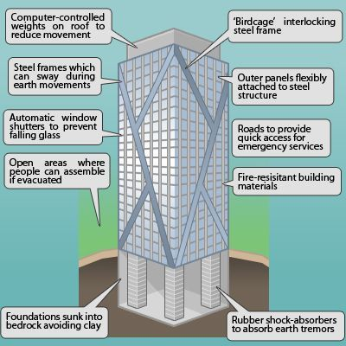
Aim
Our aim was to design, create and test an earthquake resistant building, made out of blue tack and spaghetti, with a budget of $60. Success in this challenge is having a safely structured and designed building that will withstand an earthquake. Failure in this challenge is having our building collapse during the trial, and therefore not withstanding an earthquake. It is important because it gives us a perspective on the challenges engineers face to aid those whose lives have been devastatingly altered by earthquakes, and need support to thrive again whether that be building schools, workplaces, markets or homes.

Slide 5
Requirements
Requirements that we needed to include were;
A base with a maximum measurement of 30x30cm
A minimum height of 60cm
Our design can only be made with blue tack and spaghetti
It must be quick and easy to assemble
It must remain standing after testing, which simulates an earthquake
It must cost less than $60 to build and given that 10cm of spaghetti costs $1 and 1 gram of blue tack costs $1

Slide 6
Results
For our first prototype, we designed an intricate triangle based pyramid, with different levels. Our first challenge was it wasn’t tall enough. What we did was we added a small beam of spaghetti to the top, which we thought would be successful. Unfortunately, our plans failed and our structure collapsed before we even brought it to the testing table.
For our second prototype, we designed a square based pyramid. We realised very quickly it was too short, so we added extra beams for support. To our surprise, this prototype lasted the entire testing period.
For our third prototype, we designed an hourglass shape. Unfortunately, it was also too short, so we added an extra layer of spaghetti on top. Our structure quickly collapsed, as too much weight was added to our structure.

Slide 7
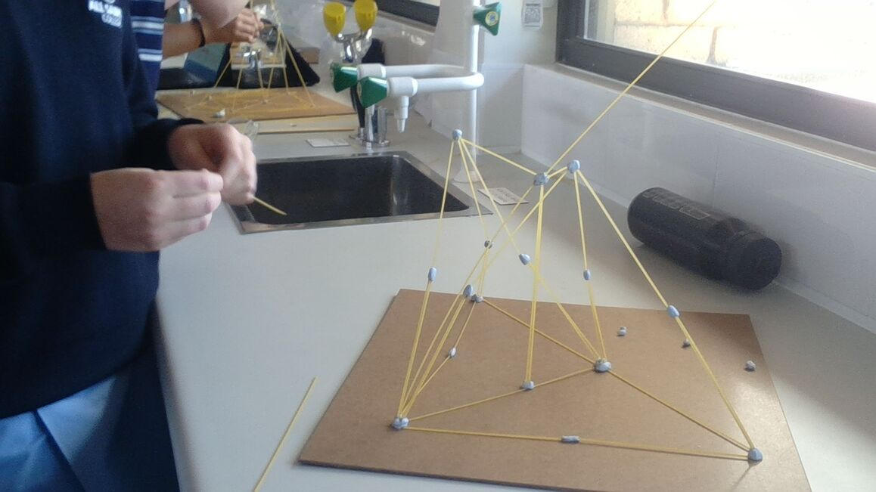
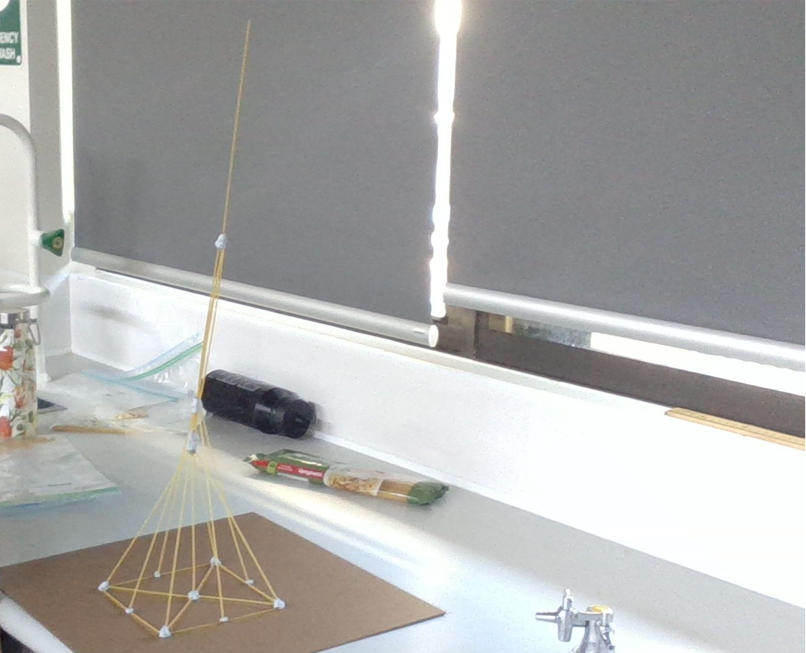
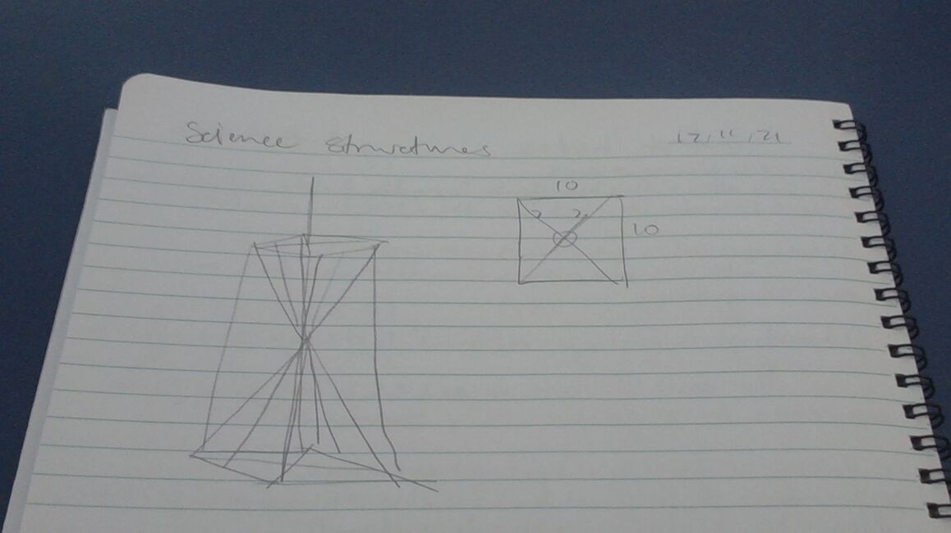
photos of our results
Prototype 1
Prototype 2
These are the photos from our first 2 prototypes, and our final design.
Prototype 3

Slide 8
Proposition to Make our design better
We could improve in a few ways on all three of the designs. The first way we can improve is by adding the minimum height requirement into our initial design instead of achieving it by adding extra parts to the top of the structure. The second way we can improve is by sticking to the initial design. The first and the third design were carefully planned out,

Slide 9
Reflection
Overall, I think that my group has done a good job of this project, whilst we may not have had the best of designs and prototypes, we worked well together to get the job done, with the challenge given to us. We were able to use our strengths to make the best out of our resources, time and effort. I think our engineering challenge was a success.

