Slide 1
Statistics Project 2021
Jack, Elliot, Hunter

Slide 2
About our Project
A survey was conducted on the All Saints’ College year 9 cohort consisting of 25 categorical questions and corresponding numerical questions.
We chose to research the questions on consuming sports content for All Saints’ year 9s' because this would be helpful to the college for co-curricular groups and sports streaming services on what the target audience and consumers want to view. The results would be interesting because there would be a variety of options and it would show a majority of some sports being more favored than others and the divide between sexes.
Our categorical question was, what is you favourite professional sport to watch, in person or television/online
Our numerical question was, in a typical week, how many times do you watch professional sport in person or on television/online

Slide 3
Validity and Accuracy of Research
These questions are great because it helps us to understand the interests of Year 9 All Saints students but there are multiple issues in how the questions are structured. The first example is the wording of the numerical question. "In a typical week, how many times do you watch professional sport (in person or on television/online)?" The first issue with the way this question is structured, how many times a week isn't an accurate measurement of time and times watched can vary because watching a 10-minute NBA highlights video on YouTube would be very different to watching a full game of AFL. A more reasonable approach would be to replace times per week with hours per week because it would give the survey participants a greater understanding of the question. The sample only accurately reflects year 9 All Saints students. Therefore, we cannot make assumptions about the entire year 9 population in other countries. For example, if the survey was conducted in a heavily soccer supporting country such as Spain, the results would be much different and year 9s would have a different result to people in their 60s-70s.
Sampling: Used All Saints’ year 9 students and this is true to this sample but we cannot infer about all year 9s or every All Saints’ students.
Bias: This is a leading question because it assumes that the sample watches sport so people are more likely to say they watch a sport when they don’t

Slide 4
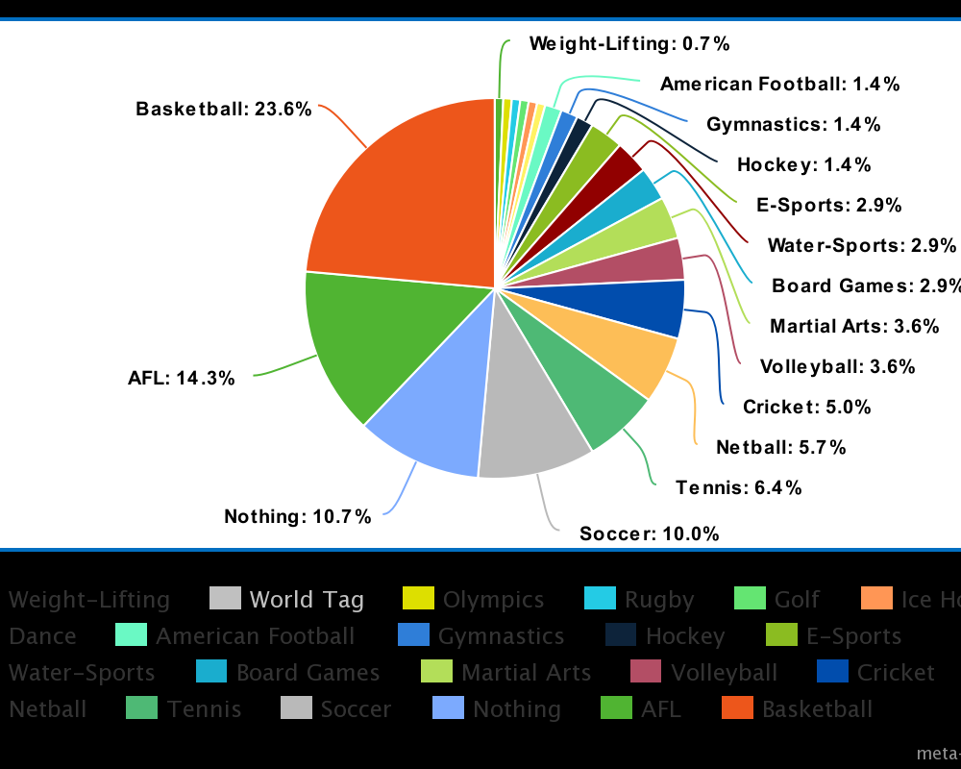
Categorical Graphs & Data
The mode is basketball with a total percentage of 23.6% and a number of votes at 33 with 19 being male and 14 being female
We weren’t expecting such a large variety of different sports
Gathering every last bit of data was difficult as people mis-spelt names of sports leading to us having to search for them individually instead of just looking with the bulk of the sports

Slide 5
Numerical Data
Times Watched (Female) | Frequency
0 | 26
1 | 22
2 | 10
3 | 3
4 | 2
5 | 1
6 | 1
7 | 0
8 | 0
9 | 0
10 | 0
Total | 66
Mean | 1.08(to 2dp)
Mode | 0
Median | 1
Q1 | 0
Q3 | 2
IQR | 2
Range | 6
Times Watched (Male) | Frequency
0 | 25
1 | 11
2 | 8
3 | 8
4 | 4
5 | 8
6 | 0
7 | 2
8 | 1
9 | 1
10 | 4
Total | 72
Mean | 2.47(to 2dp)
Mode | 0
Median | 1.5
Q1 | 0
Q3 | 4
IQR | 4
Range | 10

Slide 6
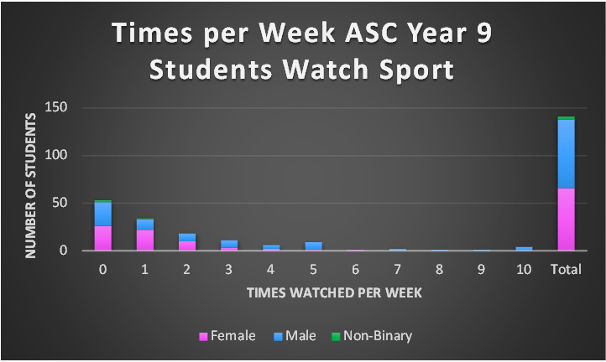
Numerical Graph
From this graph that shows the watch time between genders, we can infer that males watch more sport than females. The shape of the distribution is positively skewed showing that the number of people who watch more sport than the average decreases. We are surprised that so many year 9’s don’t watch sport, but the reason for this may be the pay wall for streaming services.

Slide 7
Conclusion
We were limited by the question structure and how people were responding with sports that they wouldn’t watch which created outliers. This lead to us having to spend more time filtering through and it making our categorical graph harder to create.
Limitations:
They change the question structure to feature hours per week rather than times per week and to change the categorical question to multi-choice with an other, please specify option.
Recommendations:
Elliot: I felt that this task allowed us realize how hard getting data is and summarizing it is even harder. This task also helped me understand how hard it is to not get non-bias data.
Hunter: I felt that this task help me better understand the topic of statistics better than any paper test could. Working with friends also benefit as you work better and more efficient with them because it is easier to communicate. This helps strengthen our teamwork, problem solving and leadership skills whereas a paper test only strengthens problem solving.
Jack: I really enjoyed this task because it was a practical task and collaborating improved our teamwork and problem solving. It was also a good experience to deal with samples and how they differ from one another

