Slide 1
Statistics Project - Streaming Services
By Jaden and Jarrad

Slide 2
Introduction
We are going to be studying the relationship between the number of hours on TV and the number of hours doing homework in a typical week as well as what streaming services people have in year 9.

Slide 3
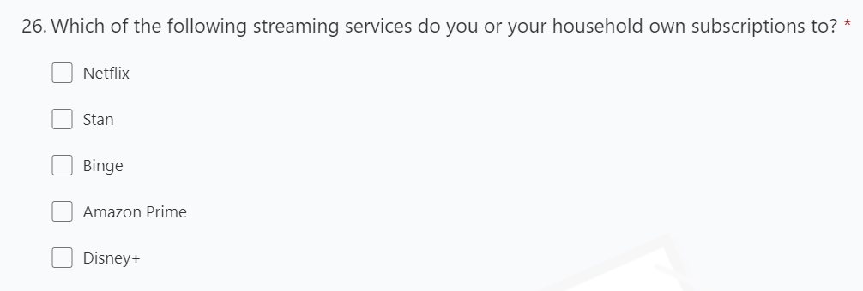
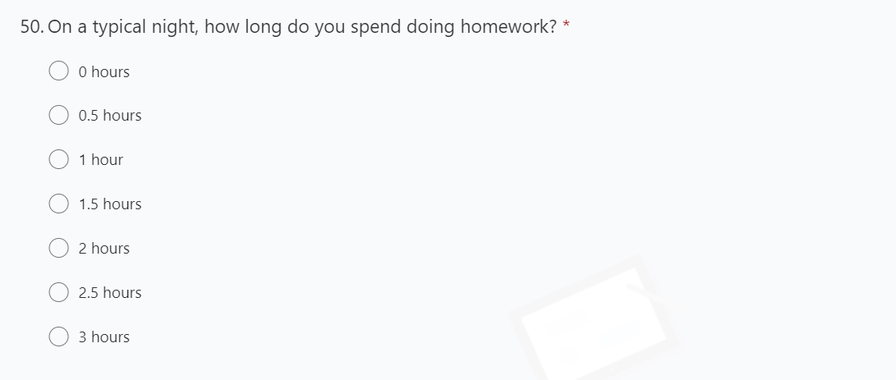
Questions
Questions we are going to be taking data from and analysing

Slide 4
Bias
The results for what streaming services people in year 9 could be bias towards Netflix because some people don't have any streaming services and they know that Netflix is the most popular service so they might choose that as their answer. Netflix was also the top option and the most likely option people would choose if they didn't have any streaming services. Also, when people don't have any streaming services, they may have lied and selected all options giving us inaccurate data.

Slide 5
Bias
The results for the question – how many hours of homework you do on a typical night could be bias because it’s a multiple-choice answer, limiting a person’s response to the question to 0 – 3 hours.
To get rid of this bias, the question should have given us unlimited choice to answer the question, like the question on hours of television a week.

Slide 6
Subgroups
Our data reflects the choices of year 9s and our math class. We split the data into male, female and non-binary so we could have subgroups and have more data.
Below are the subgroups for hours spent on tv
Male Week Hours TV
average | 5.573611
median | 3
mode | 0
range | 35
Female Week Hours TV
average | 5.615385
median | 3
mode | 0
range | 42
Non-binary TV
average | 5
median | 4
mode | multimodal
range | 9
Typical Week Hours Yr 9 TV
average | 5.580714
median | 3
mode | 0
range | 42

Slide 7
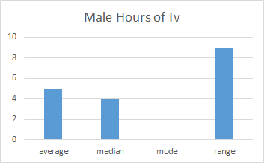
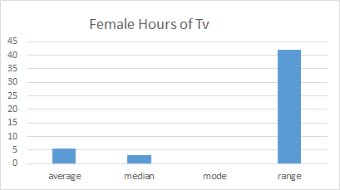
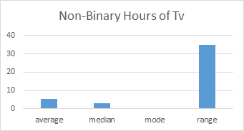
Contrasting the Subgroups Between Different Genders
The female had the highest average amount of hours of tv watched compared to the males and the non-binary. The averages were close together and they were all between 5-6 so the average of year 9 is around 5 hours. The median for females and males were both 5 and the median for non-binary was 4. Females and males both had the same mode of 0 while non-binary was multimodal because of the lack of people. The ranges of each category was very spread out with the female's range been 42, the males 35 and the non-binary 9.

Slide 8
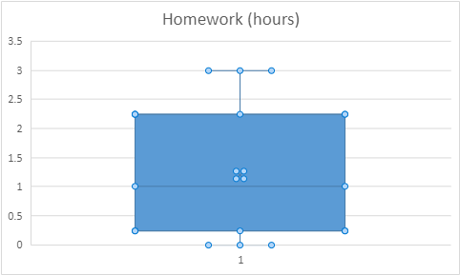
Box Plot – Hours spent doing homework every night
Minimum – 0 hours
Maximum – 3 hours
Median – 1
Quartile 1 – 0.5
Quartile 3 – 1.5

Slide 9
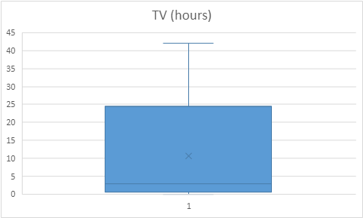
Box Plot – Hours spent watching TV every week
Minimum – 0 hours
Maximum – 42 hours
Median – 3
Quartile 1 – 1
Quartile 3 – 7

Slide 10
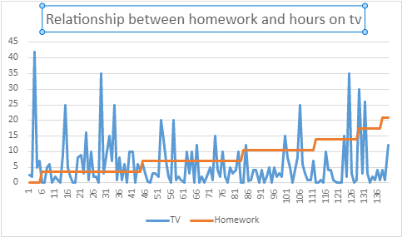
Relationship Between Homework and TV Hours Every Week
There isn’t a relationship between the number of hours people doing year 9 maths watch TV and do homework every week.

Slide 11
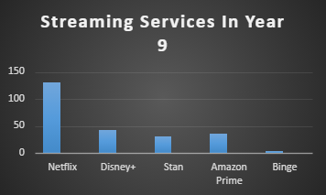
Streaming Service Choices
131 | Netflix
43 | Disney+
31 | Stan
37 | Amazon Prime
4 | Binge

Slide 12
Outliers
There was an outlier when someone said that they watched 123456 hours of tv when that isn't possible, so we excluded this data. This person also said that they have all streaming services so this person could have potentially lied so we also excluded this data.
 | Possible Outlier
Female | 12345679 |  | Netflix;Stan;Binge;Amazon Prime;Disney+;

Slide 13
Some other Outliers
For the female's subgroup of hours on tv Watched someone said that they watch 42 hours of tv a week. The second largest one was 35 hours. Using the equation UQ+1.5xIQR it was 18.5 so everything above that can be considered an outlier.
For the male’s subgroup Using the common formula I got 16 so anything above that was an outlier
For the Non-binary using the formula it was 13.75 but there wasn’t any data that was outside that number.

Slide 14
If we were to explore this topic in the future and how to stop the bias
If we were to explore this topic even more, I would have added a question specifically asking how many hours does one spend on a streaming service, but in that question, I would provide an option saying I don't have a streaming service that way it isn't bias. The data from this question could help to provide more statistics on what year 9 students do in terms of streaming services.

Slide 15
Reflection
During this task, we were able to learn how to create box plots, find the quartiles and outliers and find bias in questions.
We were able to put this new knowledge into action and analysed data from year 9 – number of hours doing homework a night, number of hours watching TV a week and owned streaming services.

