Slide 1
Sports 2
By Elle and Jas

Slide 2
Why we chose it
We chose sports 2 because we enjoy playing and watching sport. It’s useful because sport is played professionally and coaches need information to recruit players in the real world, Its also useful for making a ladder board of teams for professional sports. It’s an interesting topic because sport is a popular topic for many people.
This is a reliable way to get research because it’s a sample pf results from a real group of people. There are no bias opinions because every person in year 9 competed the questions. It would be biased if we just got information from a certain group of students but since it’s everyone the answers are not biased. It was also anonymous so people didn’t choose things that would make them look better.

Slide 3
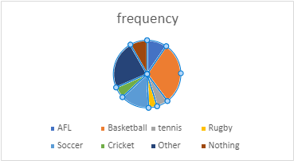
Categorical results for the males
males favorite sports to watch | frequency
AFL | 7
Basketball | 22
tennis | 4
Rugby | 3
Soccer | 10
Cricket | 4
Other | 17
Nothing | 6
mode=basketball
The results of this data shows that the mode was basketball. The sport that was
chosen the least was rugby.
AFL | 9.60%
basketball | 30.10%
tennis | 5.50%
rugby | 4.10%
soccer | 13.70%
cricket | 5.40%
other | 23.30%
nothing | 8.20%

Slide 4
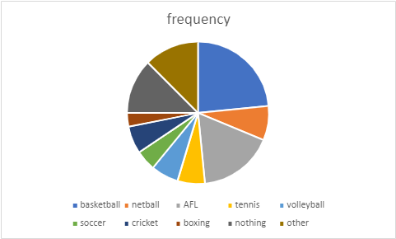
Categorical results for the females
The result of this data was that the mode was basketball. And the least chosen sport was
boxing.
Females favorite sport to watch | frequency
basketball | 15
netball | 5
AFL | 11
tennis | 4
volleyball | 4
soccer | 3
cricket | 4
boxing | 2
nothing | 8
other | 8
mode= basketball
basketball | 23%
netball | 7.80%
AFL | 17%
tennis | 6.25%
volleyball | 6.25%
soccer | 4.70%
cricket | 6.25%
boxing | 3.10%
nothing | 12.50%
other | 12.50%

Slide 5
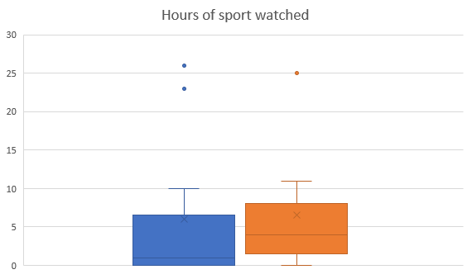
Numerical Box plots
Female Male
minimum | 0 | 0
Q1 | 0 | 1.5
medium | 1 | 4
Q3 | 6.5 | 8
maximum | 26 | 25
mean | 6 | 6.545455
range | 26 | 25
IQR | 6.5 | 6.5
 | 9.75 | 9.75
lower | -9.75 | -8.25
upper | 16.25 | 17.75
Blue- Female
Orange- Male

Slide 6
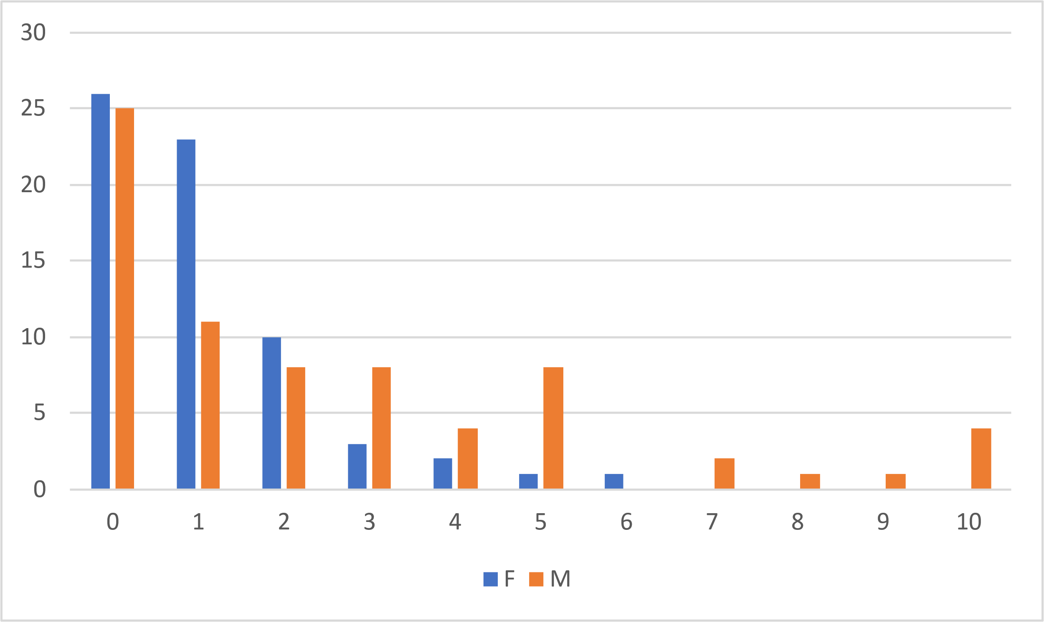
Numerical Graphs
Time | F | M
0 | 26 | 25
1 | 23 | 11
2 | 10 | 8
3 | 3 | 8
4 | 2 | 4
5 | 1 | 8
6 | 1 | 0
7 | 0 | 2
8 | 0 | 1
9 | 0 | 1
10 | 0 | 4

Slide 7
Discussing Results
In our data we did not have an outlier as most people chose the same couple options. The data is positively skewed.

Slide 8
Reflection

