Slide 1
Sports 2
By Elle and Jas

Slide 2
Why we chose it
We chose sports 2 because we enjoy playing and watching sport. It’s useful because sport is played professionally and coaches need information to recruit players in the real world, Its also useful for making a ladder board of teams for professional sports. It’s an interesting topic because sport is a popular topic for many people.
This is a reliable way to get research because it’s a sample pf results from a real group of people. There are no bias opinions because every person in year 9 competed the questions. It would be biased if we just got information from a certain group of students but since it’s everyone the answers are not biased. It was also anonymous so people didn’t choose things that would make them look better.

Slide 3
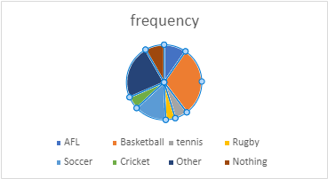
Categorical results for the males
males favorite sports to watch | frequency
AFL | 7
Basketball | 22
tennis | 4
Rugby | 3
Soccer | 10
Cricket | 4
Other | 17
Nothing | 6
mode=basketball
The results of this data shows that the mode was basketball. The sport that was
chosen the least was rugby.
AFL | 9.60%
basketball | 30.10%
tennis | 5.50%
rugby | 4.10%
soccer | 13.70%
cricket | 5.40%
other | 23.30%
nothing | 8.20%

Slide 4
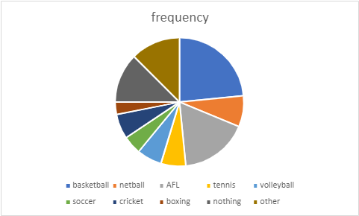
Categorical results for the females
The result of this data was that the mode was basketball. And the least chosen sport was
boxing.
Females favorite sport to watch | frequency
basketball | 15
netball | 5
AFL | 11
tennis | 4
volleyball | 4
soccer | 3
cricket | 4
boxing | 2
nothing | 8
other | 8
mode= basketball
basketball | 23%
netball | 7.80%
AFL | 17%
tennis | 6.25%
volleyball | 6.25%
soccer | 4.70%
cricket | 6.25%
boxing | 3.10%
nothing | 12.50%
other | 12.50%

Slide 5
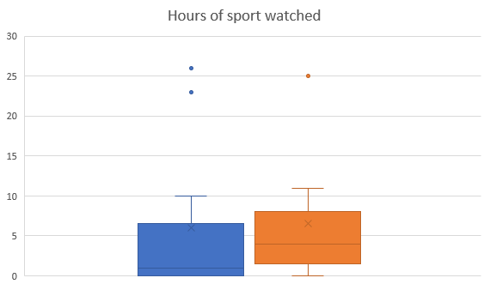
Numerical Box plots
Female Male
minimum | 0 | 0
Q1 | 0 | 1.5
medium | 1 | 4
Q3 | 6.5 | 8
maximum | 26 | 25
mean | 6 | 6.545455
range | 26 | 25
IQR | 6.5 | 6.5
 | 9.75 | 9.75
lower | -9.75 | -8.25
upper | 16.25 | 17.75
Blue- Female
Orange- Male

Slide 6
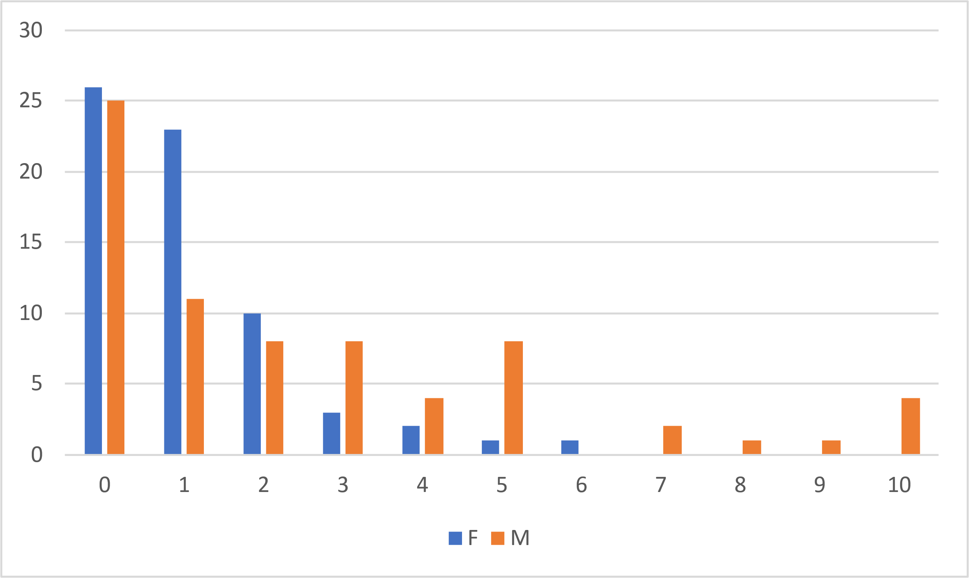
Numerical Graphs
Time | F | M
0 | 26 | 25
1 | 23 | 11
2 | 10 | 8
3 | 3 | 8
4 | 2 | 4
5 | 1 | 8
6 | 1 | 0
7 | 0 | 2
8 | 0 | 1
9 | 0 | 1
10 | 0 | 4

Slide 7
Discussing Results- categorical
In our data an outlier was marble racing, I was surprised by this because it’s not a common sport to watch and we didn’t know it was a sport. In the female is positively skewed and in the male data it is bi-modal. Basketball was the mode for females and males. We had 3 non binary people which is not enough to get results so we left it out.
Female
Male

Slide 8
Discussing- numerical
In the numerical data there is no outlier. The data is positively skewed. I was surprised that so many people watch 0 hours of sports. The mode was 0 for female and male, the median for female was 1 and the median for male was 4, the mean for female was 6.5 and for male 6. Again we did not use the non-binary answers because there wasn’t a sufficient amount of data.

Slide 9
Reflection
I think that we worked very well together. We allocated roles so we could efficiently get the assessment done. If we needed help, we would ask each other and work on it together. A struggle we ran into was when using excel the graphs were not working so we emailed Miss Da Cruz and got help from the TSC. In the end we got worked hard to complete the task. We chose to be partners because we worked well together in math’s last year and we sit next to eachother.

