Slide 1
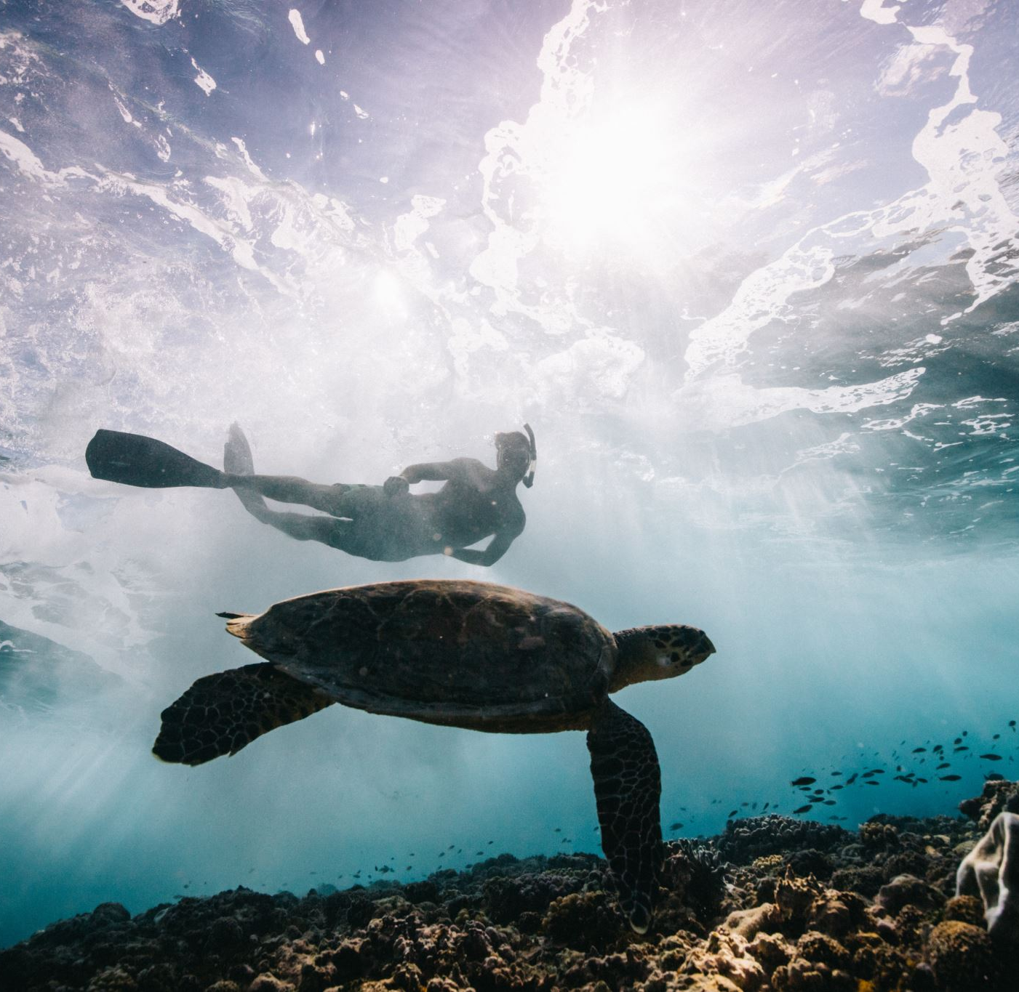
Plastic in Ocean
By Hana, Kate and Adeolu

Slide 2
Plastic in Ocean
Most of the plastic we produce on land end up in the ocean
8 million tons of plastic in the ocean each year
Increases every year
The increase of plastic promotes the growth of algal blooms a substance which is toxic to the wildlife
If this continues plastic in the ocean will outweigh fish

Slide 3
The three pillars of sustainability
Social
Standard of living
Education
Community
Equal opportunity
Economic
Profit
Cost savings
Economic growth
Research & development
Environmental
Natural resource use
Environmental management
Pollution prevention
(air, water, land, waste)

Slide 4
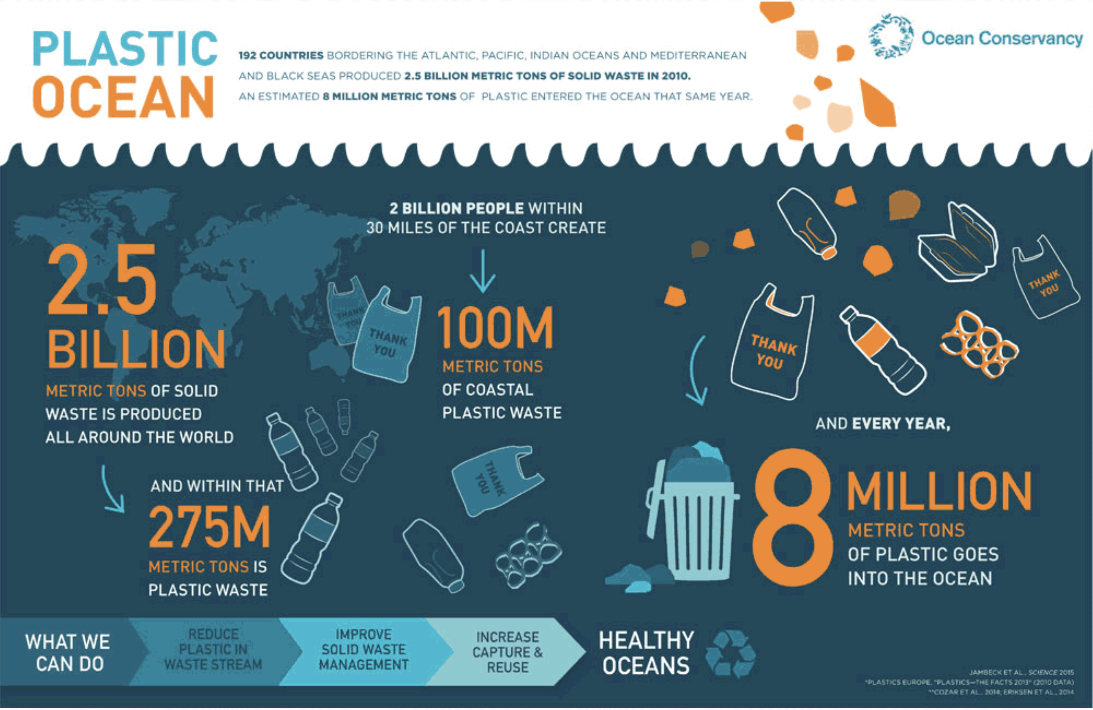
Systems
Rainwater and wind carries plastic waste into streams and rivers, and through drains
improper waste disposal
illegal dumping of waste
suffocation and entanglement of hundreds of marine species
plastic debris injures and kills fish, seabirds and marine mammals.

Slide 5
World view
Social world views on plastic in the ocean - many people all over the world are aware of the detrimental effects plastic in our oceans is having on the plant and animal life. Many people in the country attend clean the beach days held and donate to charities who help minimize the plastic in our oceans.
Economic world views on plastic in the oceans - in 2017 5.66 billion single use plastic bags have been used just in Australia alone contributing to the 8 million tons of plastic in our oceans. Because of this grocery shops such as Coles and woollies have stopped suppling customers with single use plastic bags and have been reducing plastic wrapping on fruit and veg.
Environmental world views on plastic in the ocean -
“We are throwing a garbage truck a minute into the oceans full of plastic.” UK environmentalist says. From the 1950's the amount of plastic has almost tripled. The plastic damages the coral reef and makes the ecosystem hard to live in for marine life with animals going almost to extinction and places like the great barrier reef being destroyed.

Slide 6
Future ways of thinking
Think about what is going to happen to the plastic you use
Think of ways reuse plastic
Consider the state of the ocean and ways to change it
Consider if plastic is necessary in product and if something else could be used

Slide 7
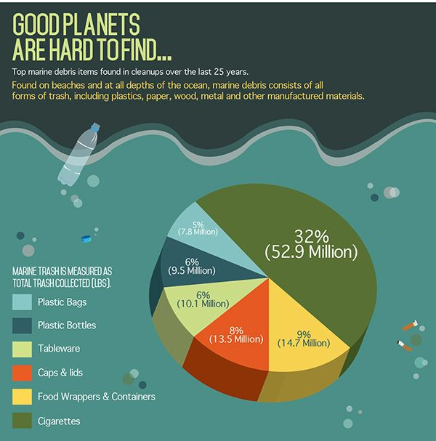
Action of sustainability
No littering
No single use plastic
Recycle reuse reduce
Use less package food
Ocean clean up day
Make stuff out of litter
Use plastic as a source of energy

