Slide 1
More money should be put into sport
By David, Kerry and Ben

Slide 2
Project overview
A problem that Australia is facing is obesity. About two thirds of our population is either overweight or obese, which is about 67%.
Our goal is to research ways we can reduce the percentage of overweight/obese people in Australia. We are focusing on how the government should spend more money on sport.

Slide 3
Current Statistics for Obesity Levels
WA – 70%
NSW – 55.2%
NT – 32%
SA – 66.7%
QLD – 32.4%
ACT – 63%
VIC – 66.7
TAS - 61

Slide 4
Current statistics in sport
WA – $158 000 000
NSW – $168 100 000
NT - $64 700 000
SA - $386 000 000
QLD - $74 875 000
VIC - $1 564 400 000
TAS - $12 500 000

Slide 5
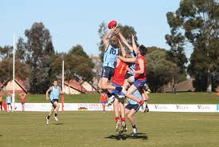
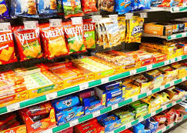
Ways to lower obesity levels
Sport
Invest more money in sport in Australia.
Unhealthy Food
Introduce a tax on unhealthy foods to discourage the consumption of it
Agriculture
Further support the production of organic food.

Slide 6
Putting more money into our sport industry

Slide 7
If a state/territory were to have more than a 50% obesity rate, then $300 per person should be invested into sport that said state/territory. If it were to be less than 50%, then only $100 per person should be invested. This is what we have calculated:
State | Amount Spent on Sport | Amount spent by Aus Gov on Sport | Total | Percentage Obese | Population | Money spent per person | Additional costs per person | Total of additional costs
NT: | 64.7 Million | $1,548,400 | $ 66,248,400 | 32% | 245000 | 270 | 0 | $0
SA: | 386 Million | $11,123,200 | $ 397,123,200 | 66.7% | 1760000 | 226 | 74 | $ 130,240,000.00
Vic: | 1.5644 Billion | $40,188,880 | $ 1,604,588,880 | 66.7% | 6359000 | 252 | 48 | $ 298,873,000.00
Tas: | 12.5 Million | $3,254,800 | $ 15,754,800 | 61% | 515000 | 031 | 269 | $ 138,535,000.00
WA: | 529.908 Million | $16,432,000 | $ 546,340,000 | 70% | 2600000 | 210 | 90 | $ 231,400,000.00
NSW: | 168.1 Million | $47,652,800 | $ 215,752,800 | 55.2% | 7540000 | 029 | 271 | $ 2,043,340,000.00
QLD: | 74.875 Million | $32,048,720 | $ 106,923,720 | 32.4% | 5071000 | 021 | 79 | $ 395,538,000.00

Slide 8
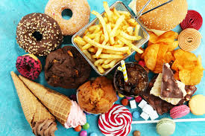
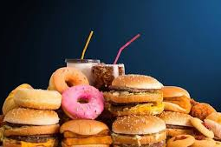
Introducing tax on unhealthy food
Another way we thought of to reduce obesity levels was to introduce a tax of 7.5% on unhealthy foods. These foods would have to have, per 100 grams, more than 20g of fat, or 5g of saturated fat, of 15g of sugar or 500mg of sodium. This would discourage people from buying unhealthy foods that can potentially cause weight gain and obesity. This tax would help obesity levels decrease over time.

Slide 9
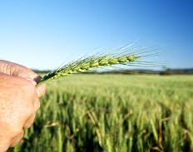
Helping the production of healthy food
The government should support agriculture more, this will not only reduce the level of obesity, but also create a more sustainable future.

