Slide 1

Maths Statistics
By Lachlan & Marshall

Slide 2
Topic
For this project my group and I are studying the types of gaming platforms used in year nine. . The reason we chose this topic is because there is quiet a large group of people who use consoles and computers for gaming purposes. There were five options to choose from which were PS4, Xbox, PC, Switch and the Wii. And the question was answered by 142 students. I think these results are quite interesting as there was such a large diversity of gaming platforms and people who use them. We will be looking at the most commonly used gaming platforms and comparing by how large their audience is.

Slide 3
Collecting Data
For this project our sampling method was a survey answered by all year nines at All Saints College. I believe that there was bias in this sample as it is not a good representation of all year nine in the state. This is because the students at All Saints College are quiet wealthy meaning they have access to more opportunity's than other schools in the state. It would have been better to look at some year nines from different school but that would have been too hard so we used convenience sample to collect our data. The question in the survey had its pros and cons. It was pretty easy to answer as you didn't have to write a response, but this did not leave any option for people who would prefer to read a book or watch TV or play a board game.

Slide 4
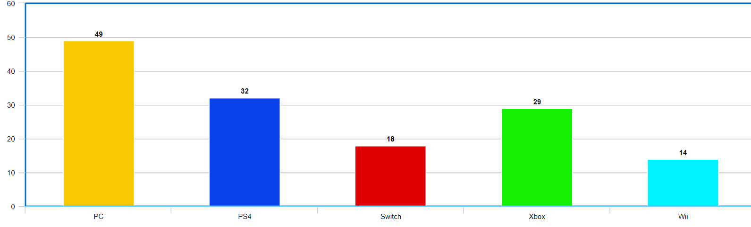
Results on A graph
Percentage Breakdown
34.5
22.5
20.4
12.7
9.9
By looking at this data its obvious to see that PC is the favourite format to play video games on. You can also see that the Wii is the most disliked format to play on.
This Data is slightly Right Skewed.

Slide 5
Categorical
For our first question about what is everyone's preferred console the unit of data we are using in categorical. It is categorical because the question is about preferred consoles and does not involve a continues number.

Slide 6
Question 2-Numerical
Our second question is how many hours a week do students play videos games for. This is our numerical question as we had to add up all the answers each student wrote and find the mean, mode, median and range. We also had to find the outliers in this question from students who wrote unlikely answers.

Slide 7





Mean, mode, median, range
Mean- 8.047705 Median-5 Range-50
Minimum- 0 Lower quartile-1 Medium-5 Upper quartile-14 maximum-50
Outliers- 84, 168, 510

Slide 8
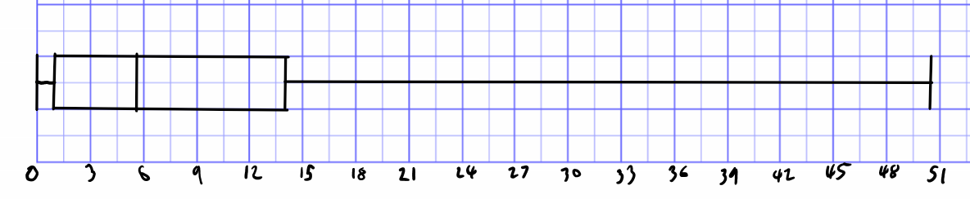
Box plot

Slide 9
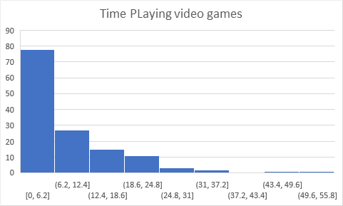
Bar graph
This is a Right skewed graph.
There was 3 outliers that were 84, 168, 510.
I believe this graph is more right skewed because parents don’t want there kids playing video games for to long during the week that’s why there is more on the left side for less hours playing video games.

Slide 10
Reflection
Marshall and I worked well in this group project. We both contributed an equal amount through this project by giving each us different topics or tasks to do while working. On the last day that this was due we had forgot to do our second question which was how many hours a week do students play videos games. Marshall and I had to quickly work and finish this task, which we did in only the first period of that double period class. Overall we worked very well together and collaborated throughout this whole project.

Slide 11
Conclusion
Categorical-For our first question about favourite formats to play video games on. The reason we believe that the Wii got the least amount of players, is because it is the oldest console on the list and barely anyone has a Wii anymore as they are out dated. The reason the PC got the most amount of players is because the PC format has a large range of games to play and has a lot more then the Wii.
Numerical- With the data that we collected that was based off the amount of time people use electronics per week we presented this data through graphs. We noticed that the hours varied from 0 to 50 hours per week. Some limitations I found in this project were using excel and learning about categorical data and numerical data. I have to learn about categorical data and numerical data and how to use excel. I noticed that some of the data the we collected was quiet high. What I mean by this is that I think it would be quiet hard to do othering things in your week like studying, going to school, physical exercise and speaking and interacting with you peers. I don’t think that all these things are possible if you are spending 40 hours a week on video games.

