Slide 1
Reducing Carbon Emissions
By Adrian Chavez-Nahui
Senuka Jayasekara
Lucas Trim
Notes:
Introduction by Senuka

Slide 2
What Maths?
Where do mathematicians fit into sustainability?
Notes:
Adrian: Many people think that Mathematics is tedious and unessential for their lives. However, for many, Maths is integrated into so many jobs and careers. Some people who immerse themselves in Mathematics can even use it to change the world. So, how can Mathematics make a change? What techniques and methods is mathematics used to enhance data and research? How does Maths help make a decision?
Adrian: Well, data has a lot to do with. Statistics is becoming more and more important in life, and mathematicians find themselves more at the forefront of sustainability. They help make maths more accessible and use their knowledge to develop technologies. Math’s and science go hand in hand, and we have decided to show this using the example of transport emissions.

Slide 3
Our Mission
To analyse and evaluate methods to reduce carbon emissions produced by road vehicles
To seek and design potential solutions to the controversy of electric cars
To investigate alternate sustainable fuels that would benefit the environment
Notes:
Senuka to read off the mission.

Slide 4
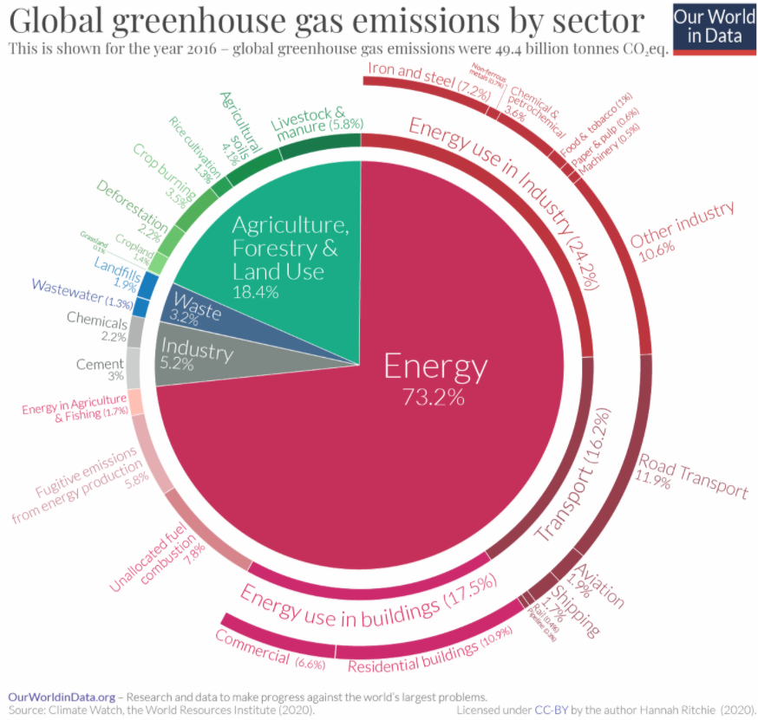
What Emissions???
Notes:
Lucas: Some people might call emissions fake news, but here’s the truth. As you can see in the graph from our world in data, 16.2% of emissions are derived from transport! That means about 8 billion tonnes of carbon dioxide equivalents!

Slide 5
Emissions by Minor Sectors
Notes:
Senuka: When we split emissions down to sectors, electricity and heat is the major contributor to emissions. But let’s take a look at the minor sectors.
*Play video*

Slide 6
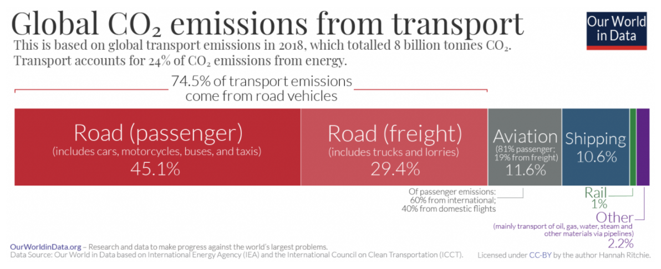
Notes:
Adrian: Now let’s see from where these transport emissions come from. You can see here that 74.5% of emissions can from road vehicles! This is about 5.96 billion tons of carbon dioxide released into the atmosphere annually. Surely we can do something about this!

Slide 7
Solving the Situation
How do we use Maths to aid solutions?
Notes:
Lucas: So, how do we use our knowledge of maths to solve the situation?
Senuka: We will split the argument into three sections.

Slide 8
Filtering Data
Using what’s useful
Notes:
Lucas: Firstly, maths is important in filtering data. Proficient mathematicians should be able to collect masses of data but only use the important parts.

Slide 9
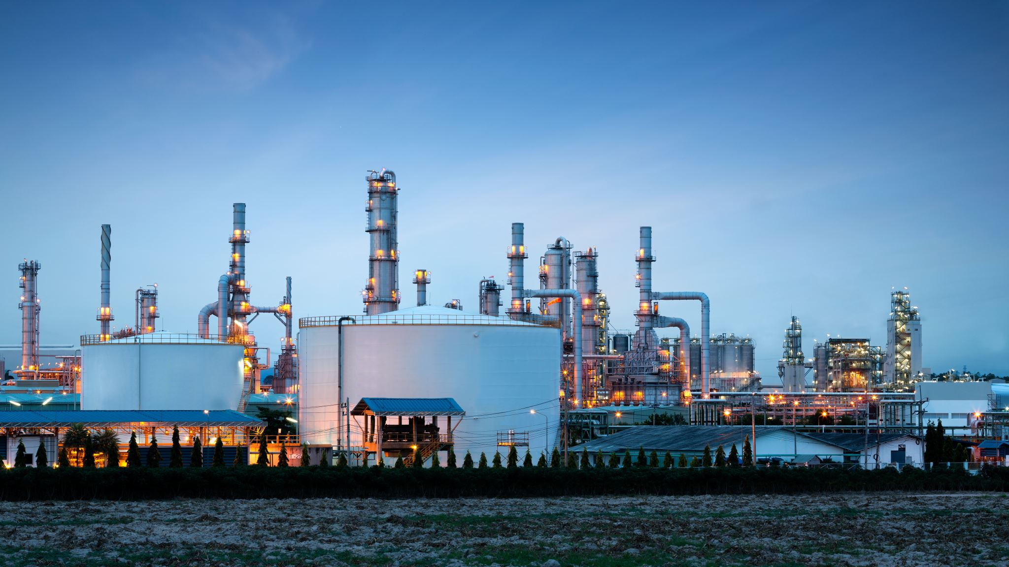
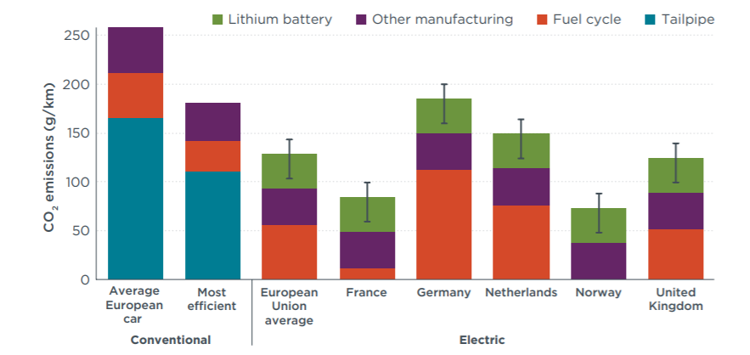
Petrol Vs Electric
Notes:
Adrian: For example, in this bar graph from the International Council on Clean Transportation, we can see here that there are many subsections for different cars.
However, all we need to look at is the leftmost bar, which is the average European car, and the Electric European Union average. Immediately we notice that electric cars do not produce tailpipe emissions, but produce additional emissions through the manufacturing of their lithium battery. Many people claim that this completely reverses the impact of electric cars, but you can see here that an average electric car still produces half of the emissions of a conventional petrol car. So that claim is incorrect.

Slide 10
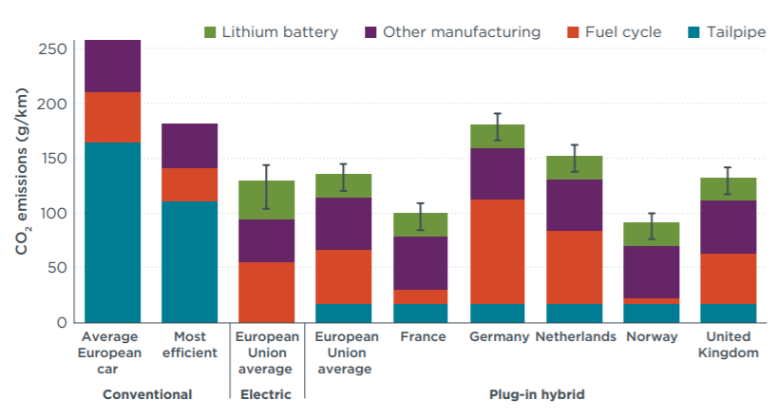
Petrol Vs Electric vs HYbrid
Notes:
Lucas: Here we see the hybrid car next to the electric car. As hybrid cars have smaller batteries to electric cars, their lithium battery production takes less emissions, however, that is made up by tailpipe emissions. Yet, we can see that there isn’t a huge difference between electric cars and hybrid cars. Therefore, we can conclude that electric and hybrid cars are much more environmentally-friendly than conventional cars.

Slide 11
Extrapolating
Making Predictions of the Future
Notes:
Senuka will cover this slide

Slide 12
Case Study: Britain
Britain is ceasing production of electric cars by 2030!
Notes:
Senuka will cover this slide

Slide 13
Notes:
Senuka will cover this slide

Slide 14
Extrapolation:
Petrol Cars | g/km | Km per year | Emissions an year per car (grams) | Emissions an year per car (tons) | Total (tons) | Total (millions of tons)
1742220 | 165 | 16093.44 | 2655417.6 | 2.6554176 | 4626322.161 | 4.626322161
26.5 years to reach 0!
Notes:
Senuka will cover this slide

Slide 15
Developing Plans
Creating our solutions and strategies
Notes:
Adrian: Finally, mathematics is important to developing plans. Using our collected and extrapolated data, we can create our solutions and strategies to the challenge we face.

Slide 16
Fuel some questions
Solutions
Problems
An alternative method to reducing emissions is by looking at alternate possibilities of fuel.
Hydrogen fuel produces no emissions
Hydrogen fuel runs a car the same distance as fossil fuels.
Can we produce enough hydrogen fuel?
How much will it cost to create hydrogen fuel stations?
How will car manufacturers need to adapt to this?
Will the prices of cars change?
Notes:
Lucas: *Read the left hand side*
Adrian: *Read the right hand side*

Slide 17
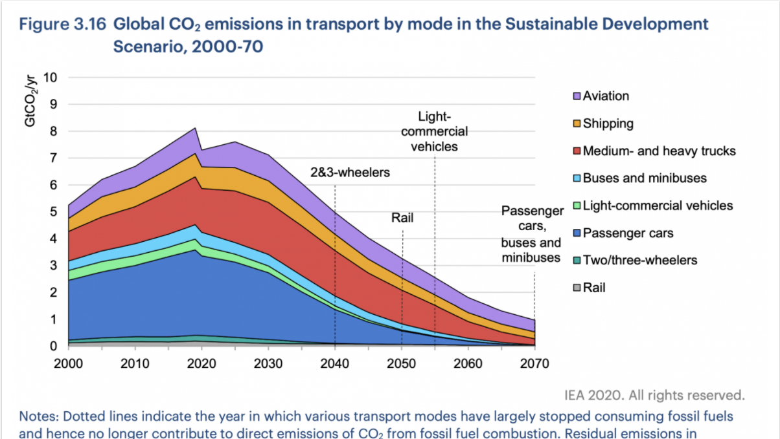
Planning for the Future
Notes:
Senuka will handle this slide.

Slide 18
Notes:
Adrian: There is no doubt that removing transport emissions is a reachable goal that we should pursue.
Senuka: We hope you now realise how mathematics is essential in planning sustainability for the future.
Lucas: We hope you enjoyed our presentation; thank you for watching!

