Slide 1
Year 9 most popular sport played
Luke and Clara

Slide 2
How was it conducted?
- Everyone in year 9 was sent out a survey to fill out a variety of questions
- There were different forms of questions such as multiple choice and written questions

Slide 3
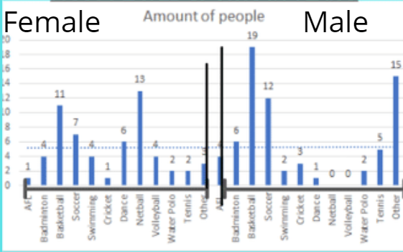
Graph 1
This is our graph we have created with our data and statistics from the survey all years 9 students filled out

Slide 4
Mode, Median and mean for females graph 1
Mean-4.8333
Mode-4
Median- 4

Slide 5
Mode, Mean and median for males graph 1
Mean-5.75
Mode-5.5
Median- 3.5

Slide 6
Outlier's graph 1
The outlier for women is netball with 13 students
The outlier for men is basketball which is 19 students

Slide 7
Graph 2

Slide 8
Mode, mean and median for graph 2
Mean= 11.333
Mode- 11
Median- 11

Slide 9
Outlier for graph 2
The outlier for graph 2 is 9+

Slide 10
Purpose of the survey
The purpose of the survey was how we created out graph, we got the statistics and data from all the year 9 students who filled out the questions on Microsoft forms.

Slide 11
Why we chose this topic
Luke and I chose this topic as we are both passionate about sports and are interested in what our peers' favorite sports are to play.

Slide 12
Conclusion
In conclusion we found that in graph 1 the most popular sport for males was basketball. For the females in graph 1 the most popular sport was netball. In graph 2 we found out that the hours most played in a week is 9+.

