Slide 1
Sport 1
By Matthew and Josh

Slide 2
What are we doing
Our group is doing Sport 1 which is what is your favorites to participate in and how many hours do you play sport a week. We choose this topic because we find this very interesting because we like to play sport. This data could be used in PE study's and we can use this to see what sports are more fun in high school.

Slide 3
Collecting data
For this project the sampling method was a Microsoft Form survey, and it was answered by all of the year nines at All Saints college. The sample size was 141 students. I have not seen any bias in the questions that we are doing.

Slide 4
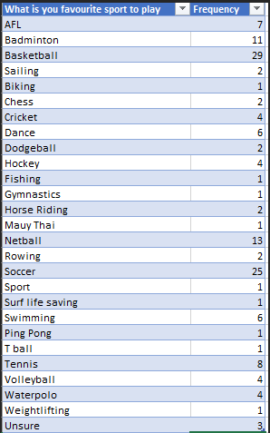
Categorical data
We chose to use a frequency table to represent our categorical data. The most popular sport played by the year nines at All Saints is basketball which was selected by 29 students and soccer followed very closely with 25 selections.

Slide 5
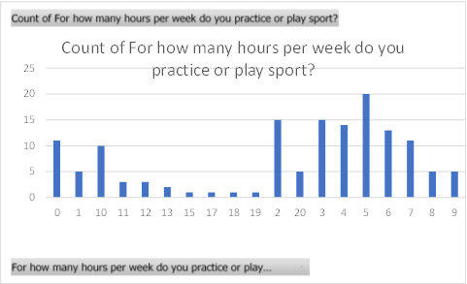
Numerical Data
The range for this was 20. the one with the most votes was 5 with 20 and the one with the lowest was 15, 17, 18 and 19 with 1 vote. The mean, median and mode are all 5. This data is negatively skewed.

