Slide 1
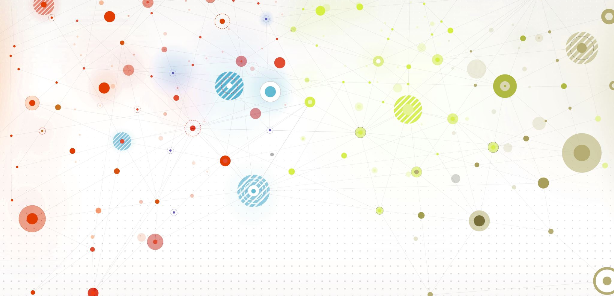
Role Models and Me
By Miah Davies

Slide 2
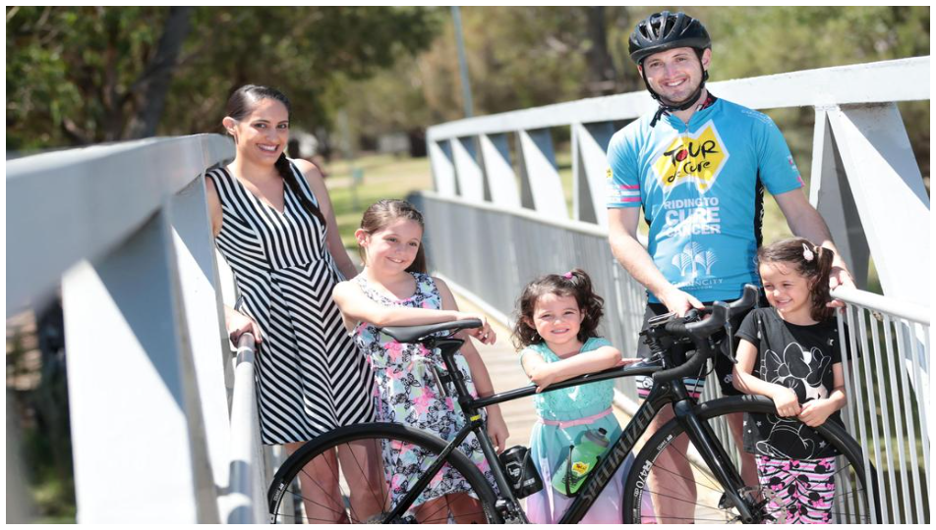
Who am I
I am Miah and I am a very sporty person. My favourite sport is basketball and I have been playing for 3 or 4 years now. I have three sisters and two dogs.

Slide 3
What makes me-me
I think my personality and facial recognition makes me-me because a lot of people remember me off my personality and face.

Slide 4
What do I value
I value a lot of things but the mains ones will be presented later on in the presentation.

Slide 5
Who can I trust
I trust my friends and family because they have been with me all the way though my life and I can trust them but sometimes when they are acting weird, I don’t trust them as much as I would normally do.

Slide 6
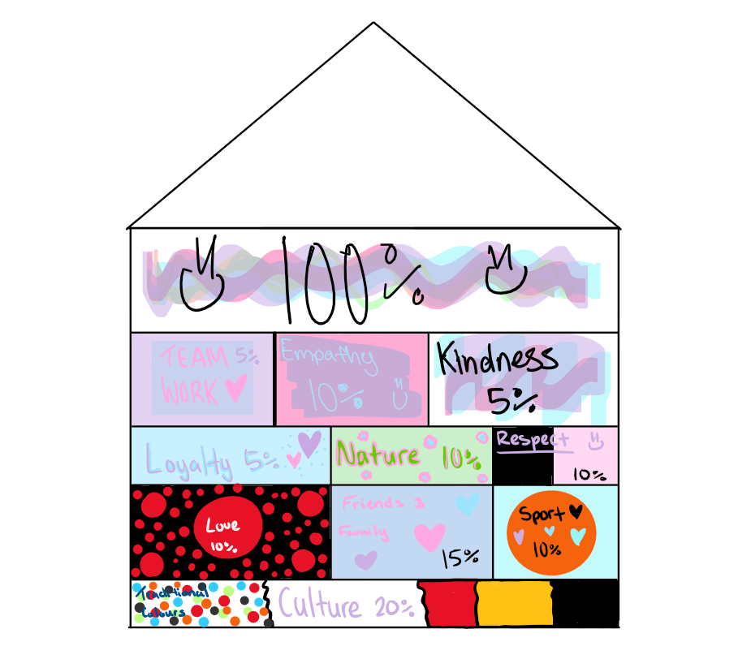
MY house values

Slide 7
Core Value 1- Culture
I chose culture because that is a big part of my family, and I am indigenous so I know some things and then my mom does a lot of indigenous stuff so that is why is my core value.

Slide 8
Core value 2- love
I chose love because I love my family and I know they love me as well, so I think that is an important value that I support, and other people should to.

Slide 9
Core value 3- friends & family
I follow this value lots because I love making and spending time with friends and then I love spending time with my family as well because to me family is important, but friends are important as well.

Slide 10
My role model- dad
My role model is my dad because he always helps people that need it and he always helps me when I need it but also, he fought through cancer then went on a bike and rode over 1,000km to raise money for cancer and show people that if you keep pushing you will always do something great for yourself and other people.

Slide 11
Bad role models
There are lots of bad role models, but Donald Trump must be the worst because he set a bad example for his country and that is why he wasn’t voted president anymore. Donald Trump thinks he is the best and only ever cares about himself with the money and power he has but when talking the country, he pretends to care about them but in the end, he only ever cared about himself.

Slide 12
The End

