Slide 1
Energy Sustainability
SOLAR POWER

Slide 2
Other sustainable concepts – potential topics
GENDER PAY GAP
The measure of average earnings between men and women
There is lots of data, however there could be quite a lot of biased data and “noise”
URBAN DEVELOPMENT
Looking at the increase of people moving to cities and the impact on sustainability
Interesting and pretty relevant to our lives, but upon further investigation it was very subjective and there wasn’t a lot of data, its mostly ideas
CLIMATE CHANGE
A change in the average condition such as temperature and rainfall in a region over a long period of time
Lots of data but a very big topic; would have to choose a smaller part. There would be a lot to talk about, but the topic has already been done a lot and harder to find something original

Slide 3
Could we increase Australia's use of solar?
For our project we explored the impacts of increasing solar use in Australia
We found out how much of our energy use is solar then set a target of what we wanted to increase that use to
We used data and our own calculations to work out the cost and effects of meeting this target

Slide 4
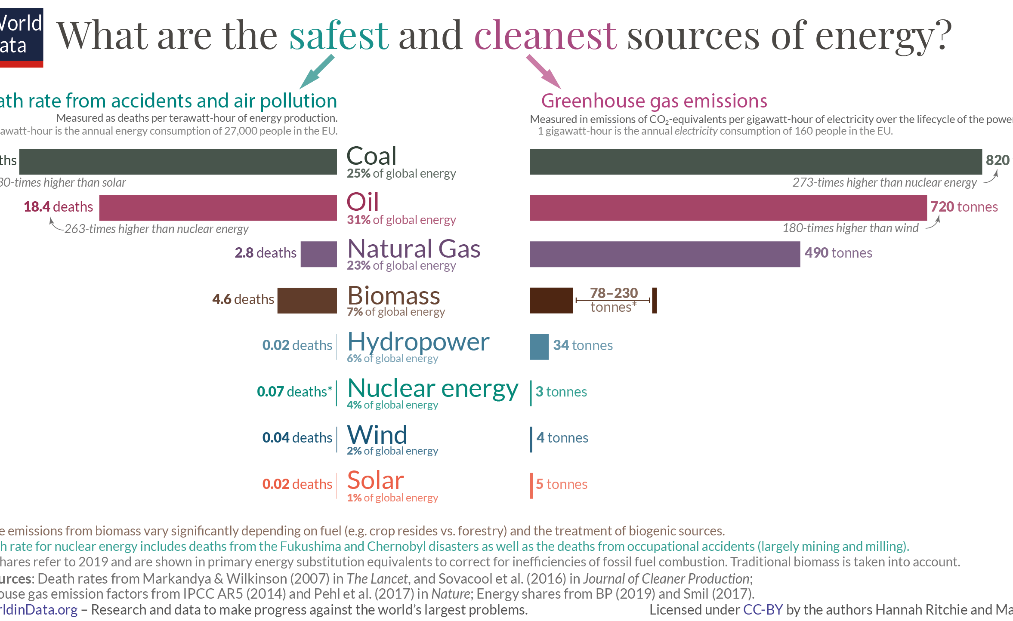
Why solar?
Our current use of energy is unsustainable. Our heavy reliant on fossil fuels both depletes resources and pollutes the atmosphere
Renewable energy, such as solar, doesn't have as big an impact on the environment and will last much longer
Solar is one of the safest and cleanest sources of energy

Slide 5
Initial calculations

Slide 6
In perspective: cost
There would be a cost to this, however with a bit of sacrifice it would be achievable

Slide 7
In perspective: cost
Short term, sticking to fossil fuels is cheaper in terms of the cost
Partly because coal stations already exist, whereas renewable energy involves creating new power stations
However, it is best for our financial interests to invest in renewables now, as climate change will cost us further down the track
Projections about how much climate change is costing us are complicated and not entirely accurate
Projects supported by the Climate Council and MSSI have used modelling to estimate that the cost to Australia not meeting it’s Paris Accord target from now to 2050 is $1.19 trillion

Slide 8
Reduction in emissions?

Slide 9
Summary
There are still problems posed, such as the reliability of solar panels and what to do with the waste when they die
Based on our calculations, increasing our solar use by 8% is likely to cost us around $51 billion, or around $2 billion a year over a 25 year investment
If people are willing to sacrifice a little, this is something that is achievable
While it is only an 8% increase in renewable energy, every increment helps when tackling an issue like this

