Slide 1
Factories Sustainability
By: Emma, Royce, Sam, Lehan

Slide 2
Factories
Majority of our production is from factories.
Estimated of 10 million factories in the world
Livestock's have a larger unsustainability
Factories are to blame for as much as 2/3rds of the pollution that has caused climate change.

Slide 3
Factories pollution or Harm
Water pollution
Air pollution
Soil pollution
Our own health
Destruction of wild life
Global Warming

Slide 4
How can we solve the factories problems?
How maths can be utilised in supporting sustainable factories
Predicting the future: Using maths to predict how the world will look in the future e.g. amount of CO₂emissions.
The data used from these predictions can be used to analyse possible factors for unsustainability and provide clues for a direction to reduce CO₂ emissions.
Maths can also be used to gather data on the amount of CO₂ and measure it. The maths can also be able used to find the best solutions and determine which is better, e.g. Fossil fuels or renewable energy.
Maths can also be used in calculating the optimal positions for renewable energy sources such as windy places for wind energy. Or like unstable oceans for hydro.
After analysing the collected data, math can also be used to create new machines that can solve the problems.

Slide 5
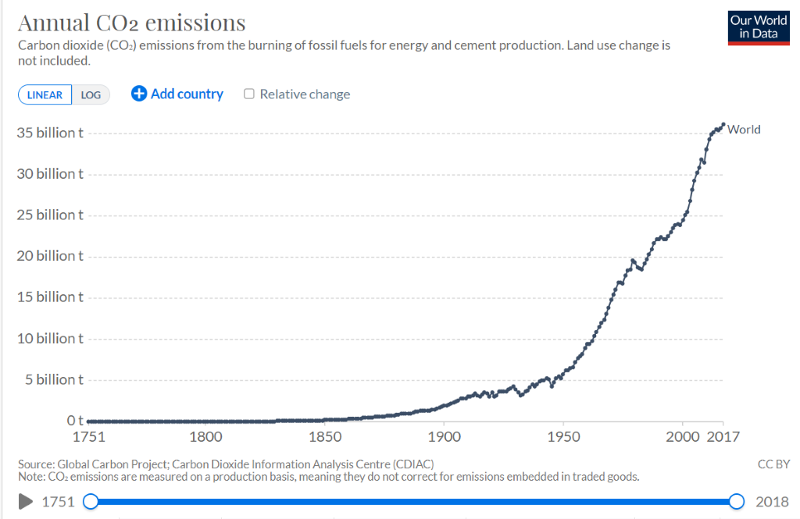
DATA and the effects
There is over 35 billion tons of annual carbon dioxide emissions in the world, the country producing most of these is China
The curve over the last fifty years suggests that the use of cars have had a massive impact on carbon dioxide emissions
Solutions such as fossil fuels have proven to not make a difference in the emissions and with the use of maths, we need to find solutions that benefit this problem

Slide 6
Conclusion
Throughout the project we can conclude that mathematics can be used as a persuasive tool for analysing, transferring knowledge by being engaging. This was shown in the project as we provide engaging data to show the problem that factories have on our society. This has been shown through the data that we have learned that the most profitable factories is the least unsustainable. This needs to be changed. Hence, we come up with ways to make factories sustainable at a low cost. This should help decrease the pollution factor of air, water, soil pollution and personal health.
This is how data can be used.

