Slide 1
Statistics
By Sienna Gorman and Kaiya McPhee

Slide 2
Topic
Our topic is Streaming services
We will be calculating which streaming service was most popular amongst year 9 students and the number of subscriptions on average for their families.
These results would be interesting because we would get an opportunity to identify which streaming services were the most popular and unpopular. Saying this, we can also compare the difference of popularity between each streaming platform.

Slide 3
Research Methods
Our research method was a survey and we surveyed all year 9 students at All Saints College. Our sample size was a convenience sample meaning we chose to survey these students because they are accessible. When surveying students, we must ensure the sample size is unbiased so choosing to ask this particular group of people meant the survey results would have been fair. Although this sample size is accessible and quick, it doesn't speak for the whole population. Even sampling 4 other schools consisting of other year 9's would have given us an incredibly different result to what we have now. The reliability of a survey is usually very accurate depending on how well the question is written and responded to. If the question can be interpreted in many ways, the responses are often not very reliable and can be very random. Both streaming service questions were very reliable as one of them was a multiple choice and the other you had to pick a number from 1-10.

Slide 4
Categorical data
Amazon Prime | 5 | 3.50%
Disney Plus | 2 | 1.40%
Disney Plus & Netflix | 16 | 11.30%
Netflix | 69 | 48.90%
Netflix & Amazon Prime | 10 | 7.10%
Netflix, Disney Plus & Amazon Prime | 7 | 5%
Stan | 2 | 1.40%
Netflix & Stan | 5 | 3.50%
Netflix, Amazone Prime, Disney Plus & Stan | 7 | 5%
Netlix, Stan, Binge & Amazon Prime | 1 | 0.70%
Netlix, Stan, Binge, Amazon Prime & Disney Plus | 3 | 2.10%
Netflix, Stan, Binge & Disney Plus | 1 | 0.70%
Netflix, Stan & Disney Plus | 8 | 5.70%
Netflix, Stan & Amazon Prime | 5 | 3.50%
Mean- 10.1
Mode- Netflix
Median- 5
Range- 8
Lower quartile- 2
Higher quartile- 9
Interquartile range- 7
Outlier- 69

Slide 5
Numerical Data
1 | 13 | 9.20%
2 | 28 | 19.90%
3 | 34 | 24.10%
4 | 25 | 17.70%
5 | 14 | 9.90%
6 | 11 | 7.80%
7 | 5 | 3.50%
8 | 2 | 1.40%
9 | 1 | 0.70%
10 | 1 | 0.70%
0 | 7 | 5%
Mean-
Mode- 3
Median- 3
Range- 1
Lower quartile- 2
Higher quartile- 4
Interquartile range- 2
Outlier-

Slide 6
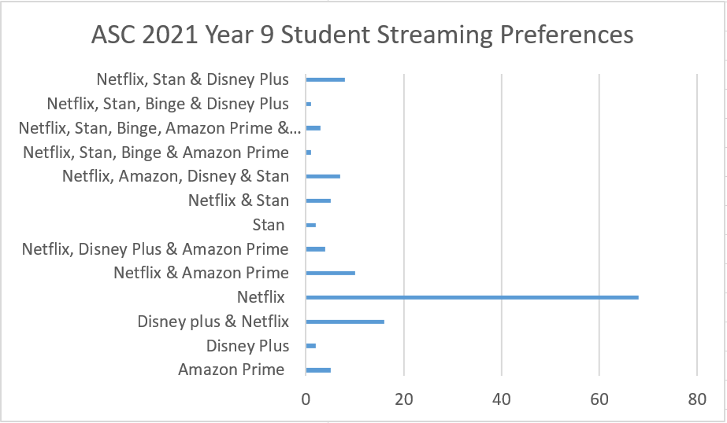
Categorical Graph

Slide 7
Numerical Boxplot
ASC 2021 Year 9 Student Owned Streaming Services

Slide 8
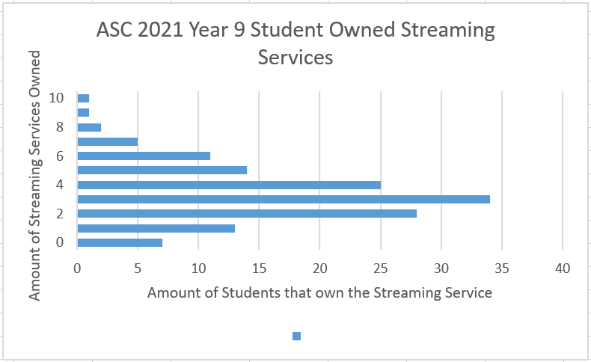
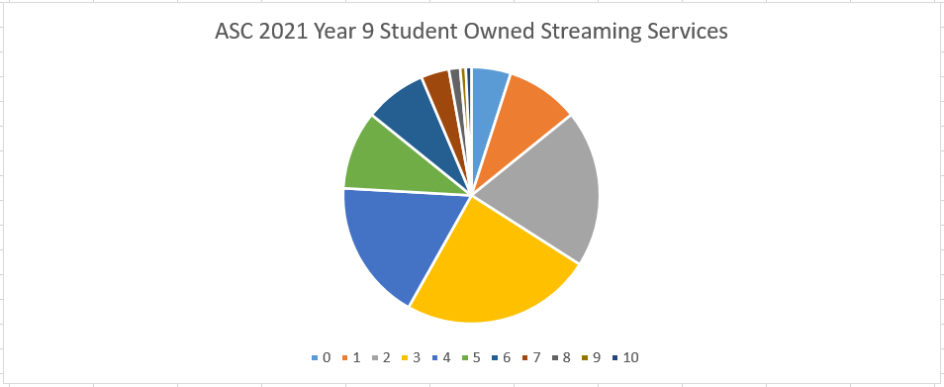
Numerical Graphs

Slide 9
Discussing our Findings
Some relevant statistics in the categorical graph would be how much of a difference there was in terms of frequency between Netflix and the other streaming services.
Netflix had a frequency of 69 while the rest had a frequency of 16 or lower.
The shape of our categorical graph wouldn't be considered symmetrical, bimodal, or skewed. It seems there is only one clear standout which is Netflix while the rest are all roughly similar. Our numerical graph however, seems to be symmetrical as well as 'skewed to the left.' The three top scores are fairly similar and are all placed in the middle while the rest of the scores on either side and are all roughly smaller. The smallest scores are placed on one side of the graph which is what is causing the graph to be skewed to the left.
A potential explanation for our results would be that Netflix seems to be very popular amongst teens and often over rides any other streaming service. This means the majority of kids in year 9 would prefer Netflix over any other streaming platform.
A surprising feature we discovered was that only two students owned a subscription to Stan only. We figured that Stan was still a popular streaming service even though many prefer Netflix, so for this reason we assumed there would have been a higher frequency for Stan only.

Slide 10
Summary
Going into this project we weren't super confident with the topic and the tasks in general, but we managed to successfully complete each task while working efficiently.
Some limitations we experienced were that some of the streaming services had a semicolon written after them even if they were the exact same streaming service. This means it would have been harder to count them using a formula on excel so we decided to count each one manually which still look a bit of time.
A future recommendation for ourselves would be to possibly choose an easier topic when collecting data because of the written errors made my students like the semicolon.
Analyzing and sorting the data was the area we most struggled with because we kept missing pieces of data and we had to keep re-counting it.
Overall this particular math's project was a bit difficult to get started with but became easier to understand as we continued to work on it.
We both think we worked really well together and shared the load equally. We made sure to use our class time effectively and share the amount of tasks. We chose each other as partners as we enjoy being together but we also think when we need to work we can focus together. We checked each others tasks we did to make sure we both agreed and gave feedback.

