Slide 1
Interview with Ms. Mano

Slide 2
Team Red
Sam, Evan, Tom

Slide 3
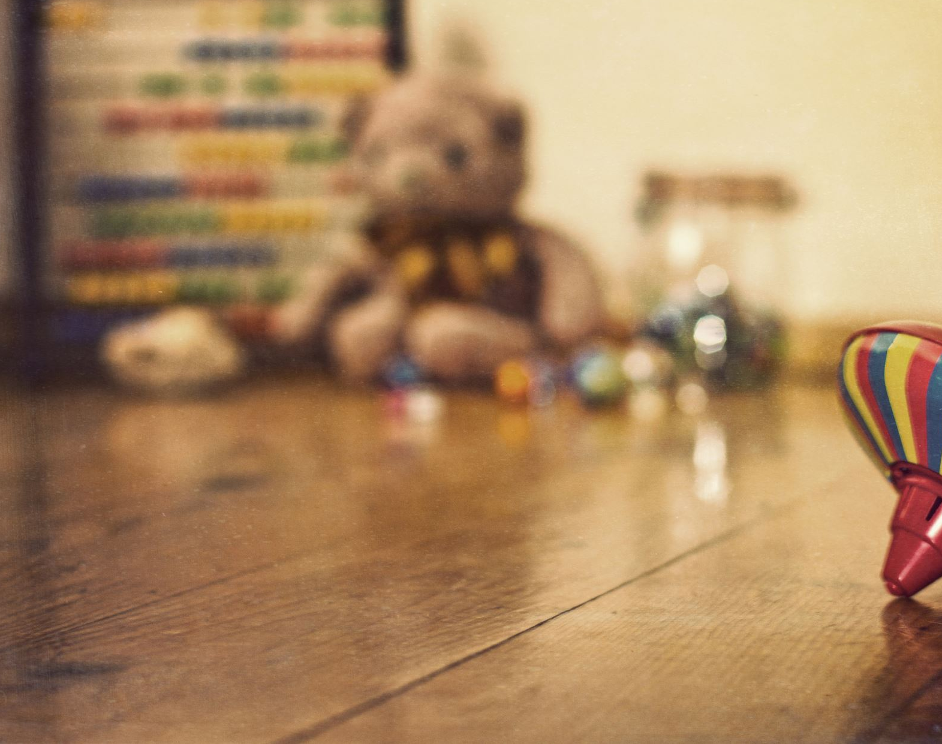
Apart from playing with toys, what do the kids love doing?

Slide 4
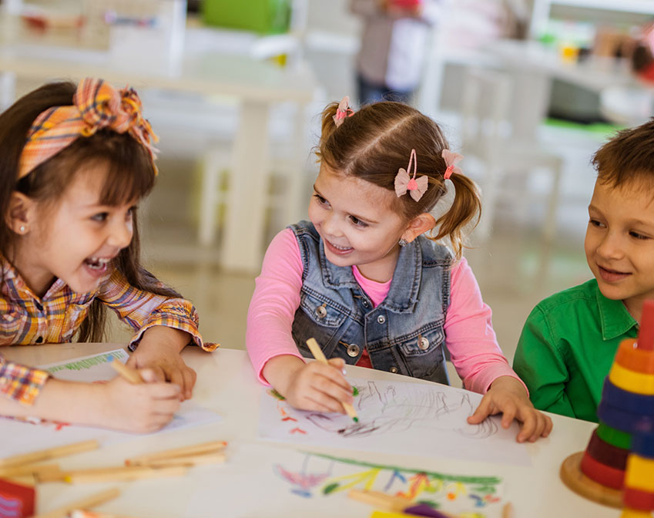
What have you noticed about how the students interact with their friends?

Slide 5
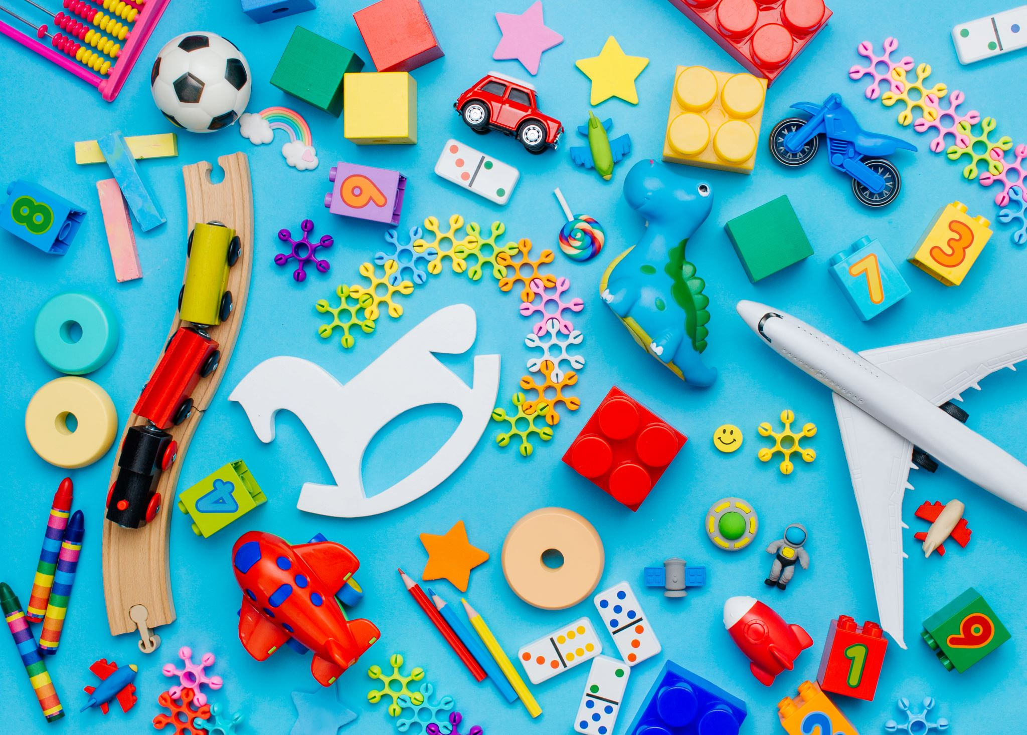
Which toys do the students tend to play with the most?

Slide 6
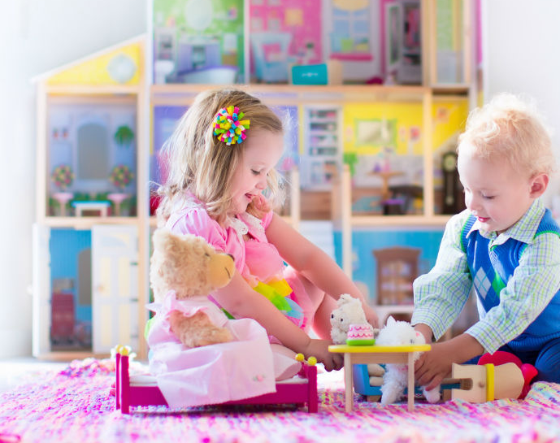
Do girls and boys tend to play with different or the same toys? If different, how are they different?

Slide 7
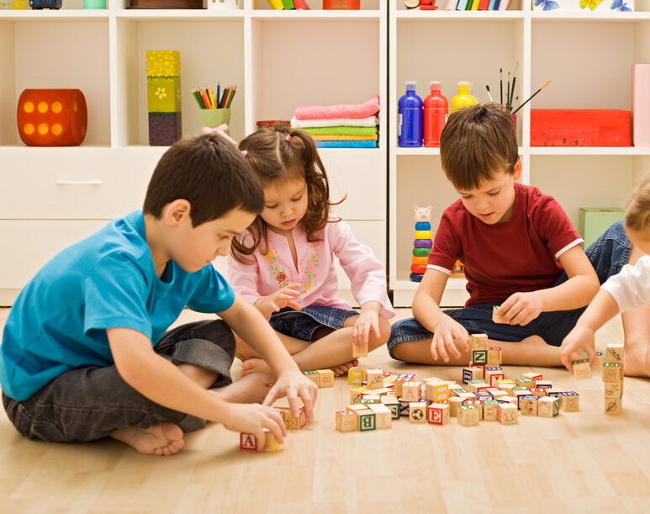
On average, how long do most children spend playing with a toy?

Slide 8
Team Blue
Jack, Tiana, Taryn, Sienna

Slide 9
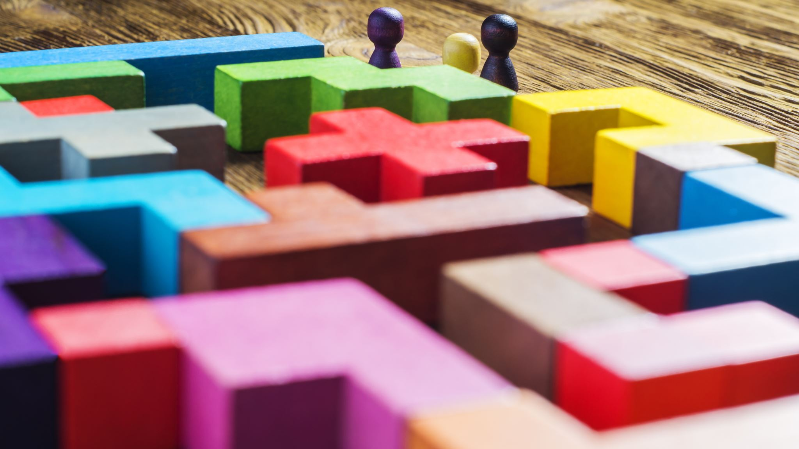
What are the most played with/popular toys in the Early Learning Centre?

Slide 10
What are you hoping the students will learn via toys?

Slide 11
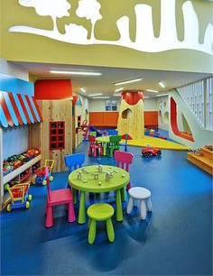
What kinds of toys are the students encouraged to play with in the Early Learning Centre?
Notes:
HI

Slide 12
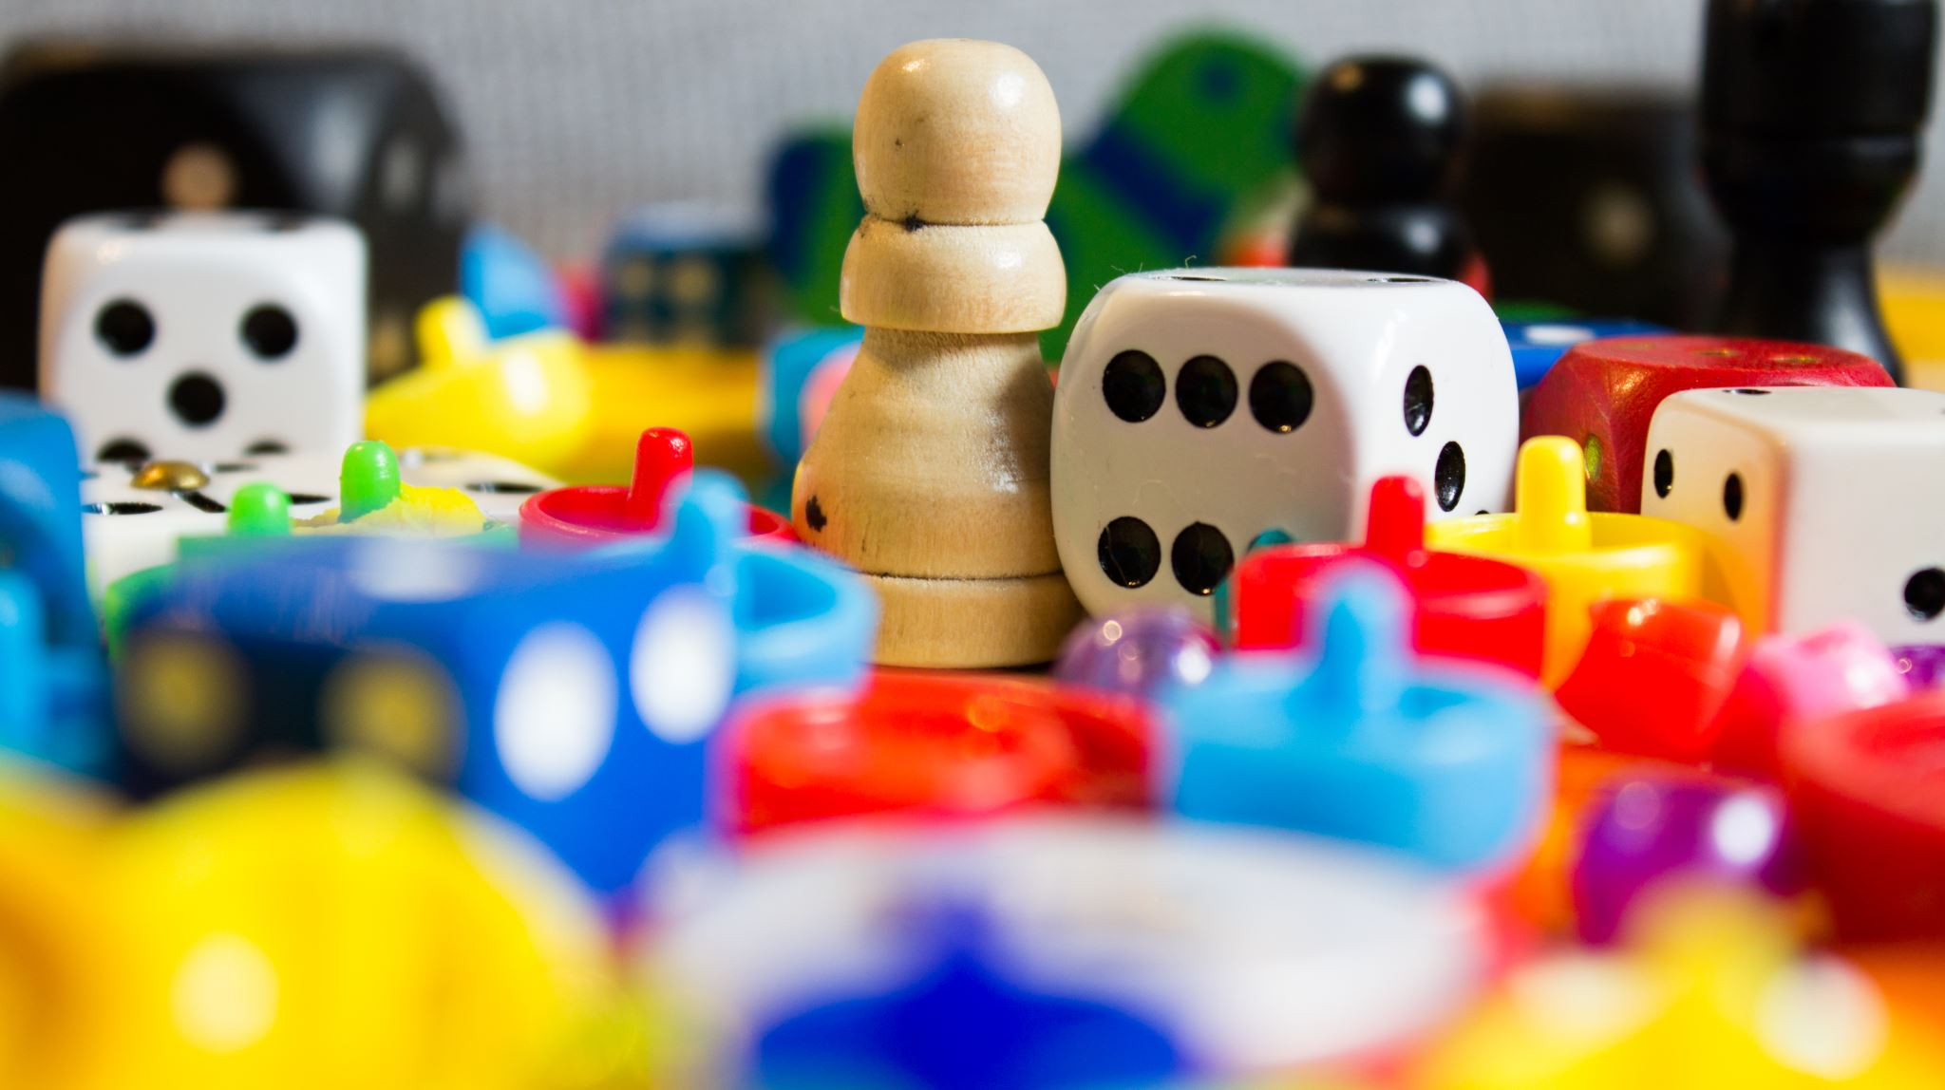
Can the children share toys effectively? When they do, do they enjoy it more

Slide 13
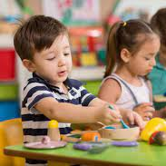
What are the students’ favourite topics?

Slide 14
What do the kids enjoy learning about

Slide 15
Team Green
Dominique, Pearl, Ithe
This Photo by Unknown author is licensed under CC BY-SA.

Slide 16
What do the students like most about coming to school?

Slide 17
What makes a toy popular at the ELC?

Slide 18
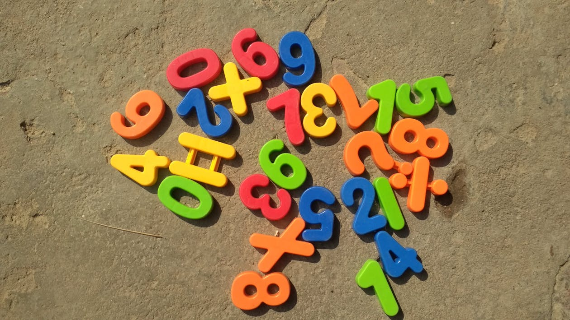
What features make the toy want to be played with by boys/girls?

Slide 19
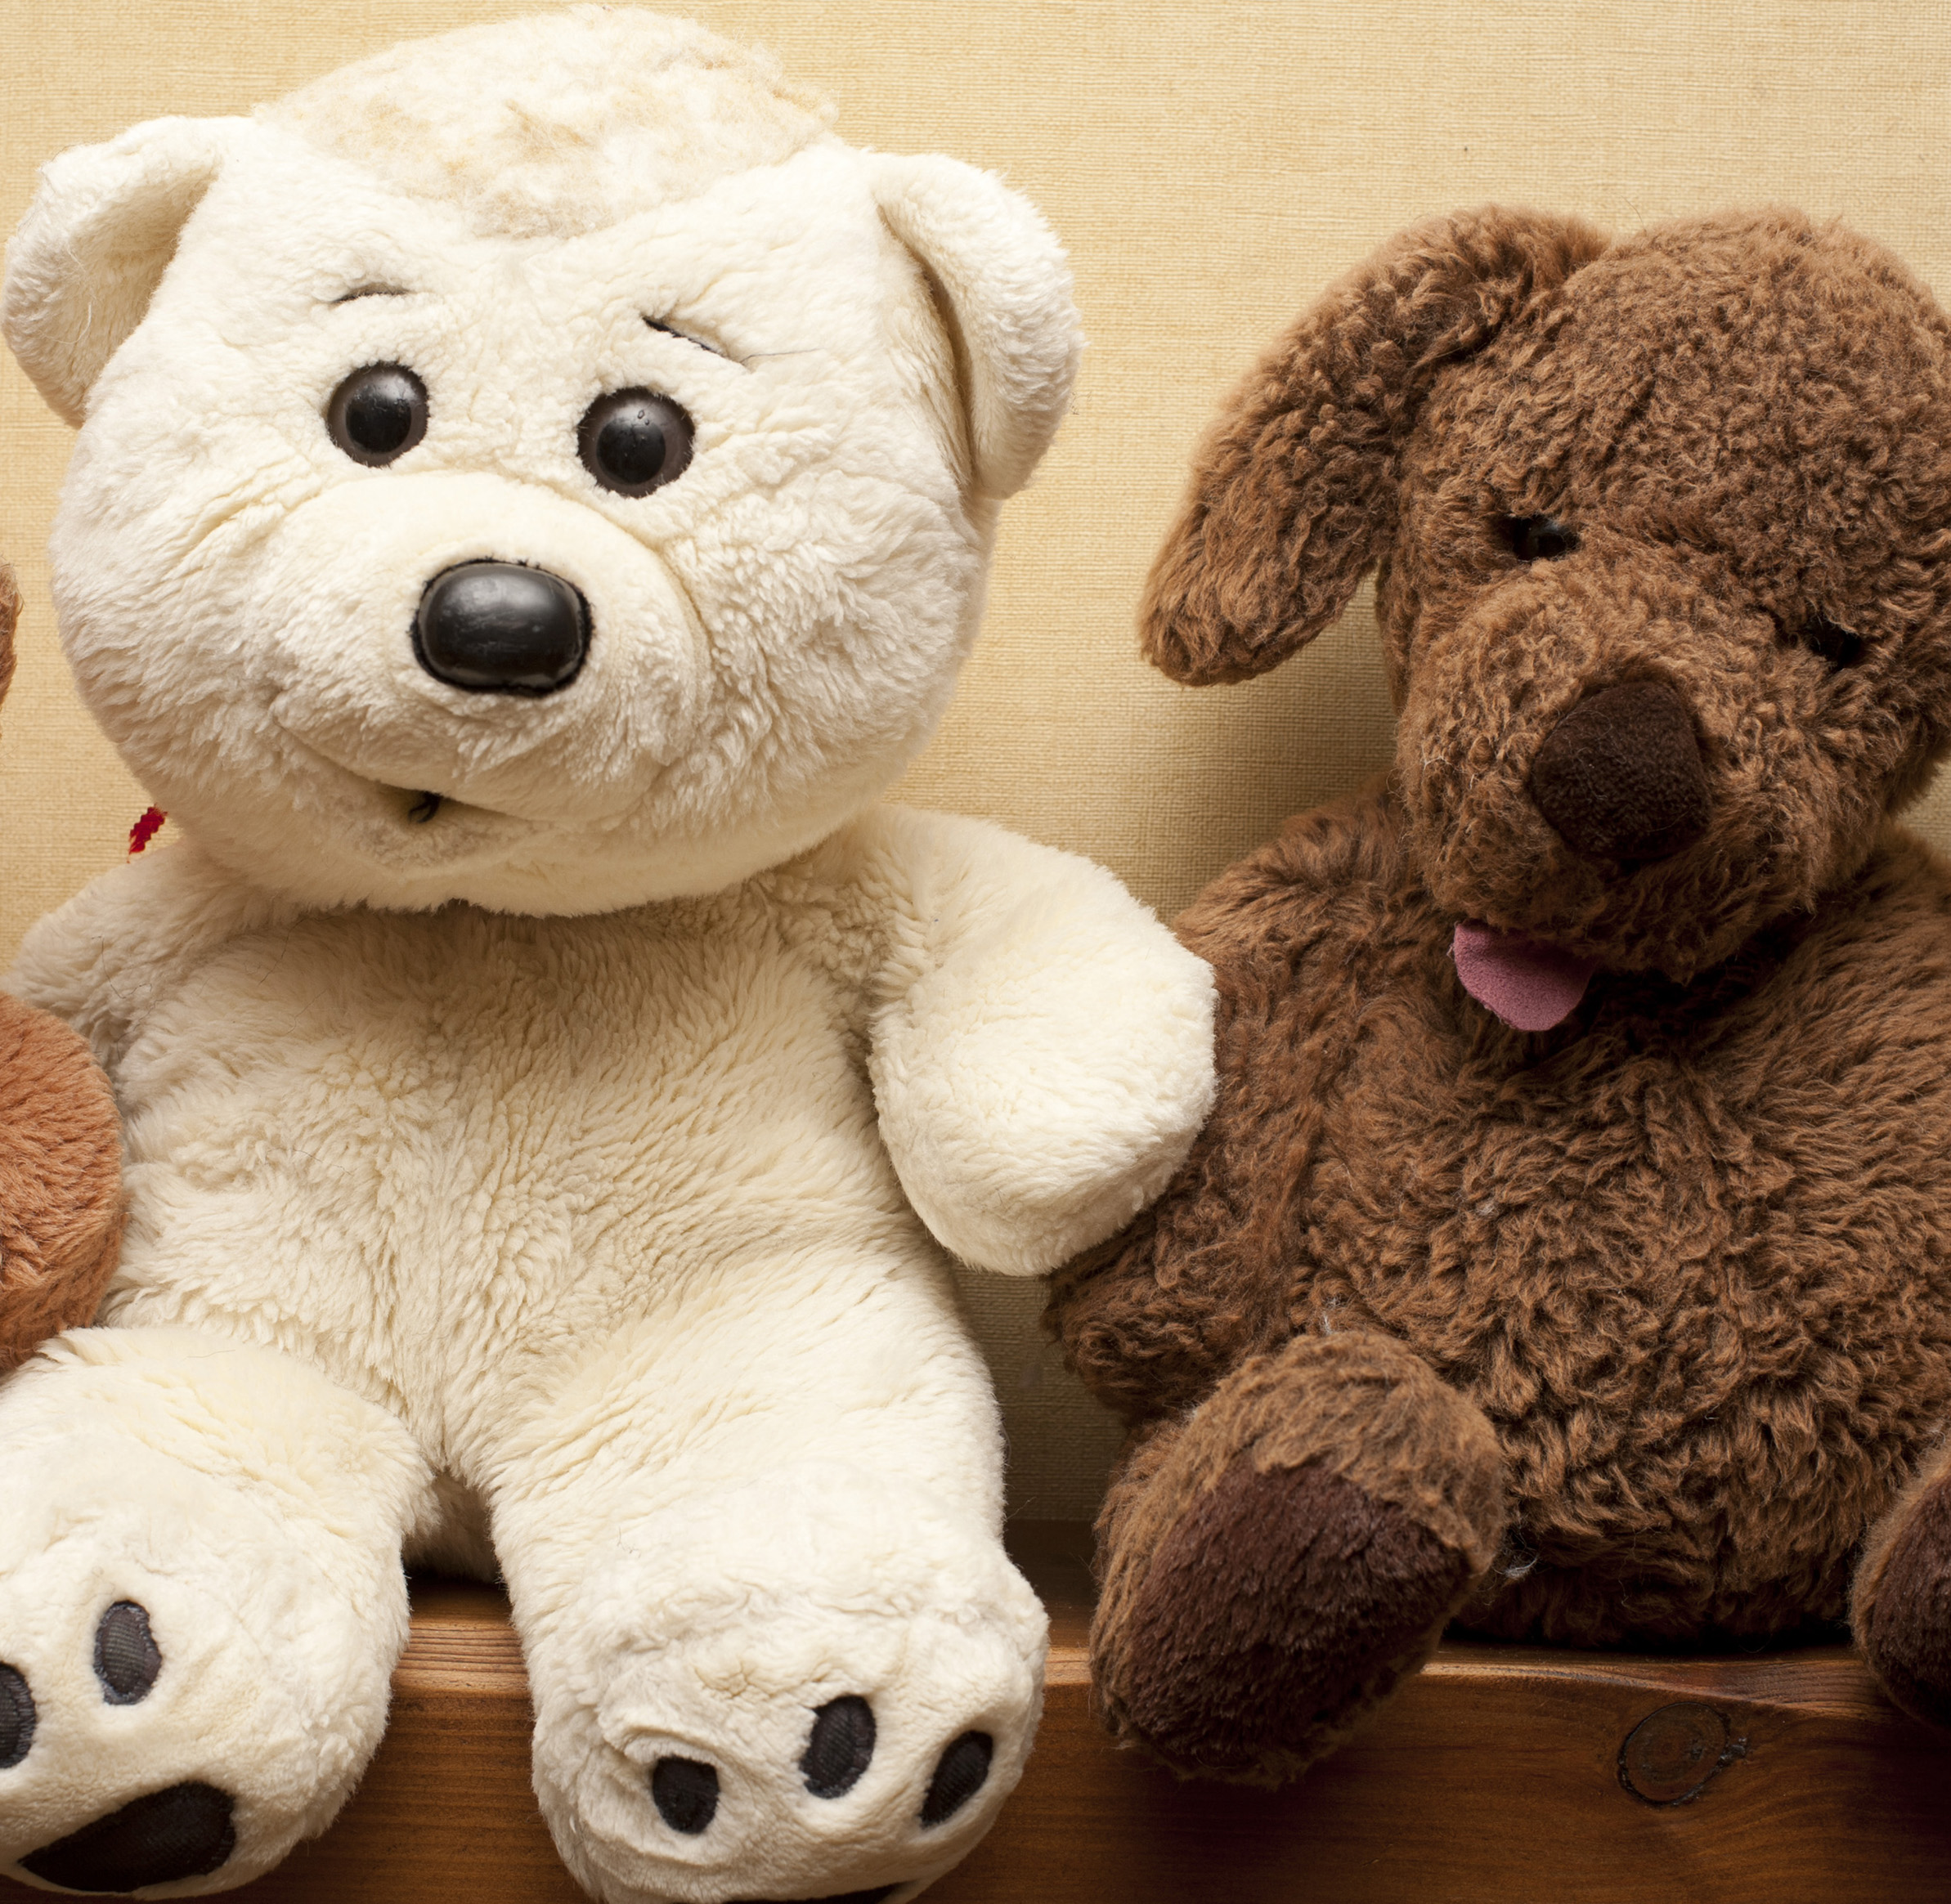
Which toy is the most played with in class? What do you think the reason for that is?
This Photo by Unknown author is licensed under CC BY.

Slide 20
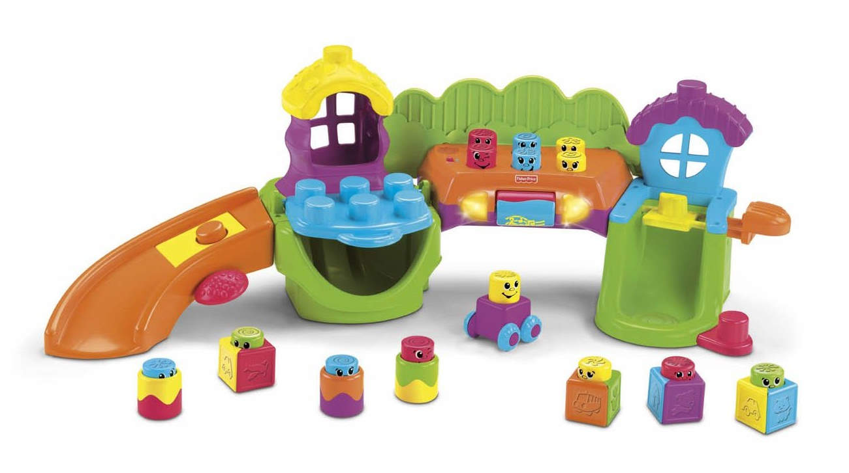
What are the similarities between the students’ least favorite toys?
This Photo by Unknown author is licensed under CC BY-NC-ND.

Slide 21
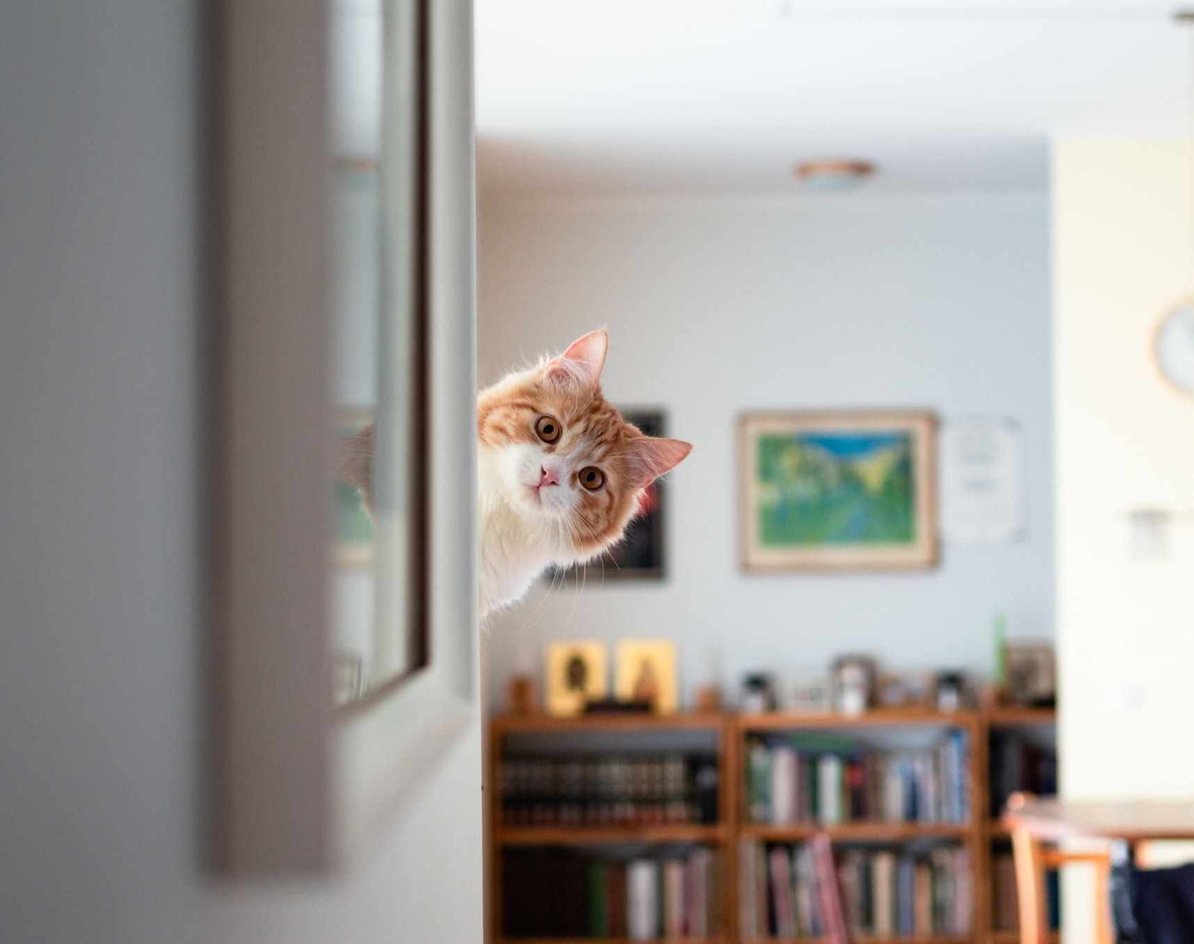
What do the kids like to do at home?

