Slide 1
A maths project about books
by William Carruthers and Howard Shen

Slide 2
What is a book?
Before we start our presentation, we need to give a brief definition about what is a book.
"Instrument that record, analyse, summarise, organise, debate and explain information that are illustrative, non illustrative, hard bound paper bag jacketed, non jacketed, with forward introduction table of contents, index that are intended for the enlightenment, understanding, enrichment, enhancement and education of the human brain through sensory route of vision... some times touched”

Slide 3
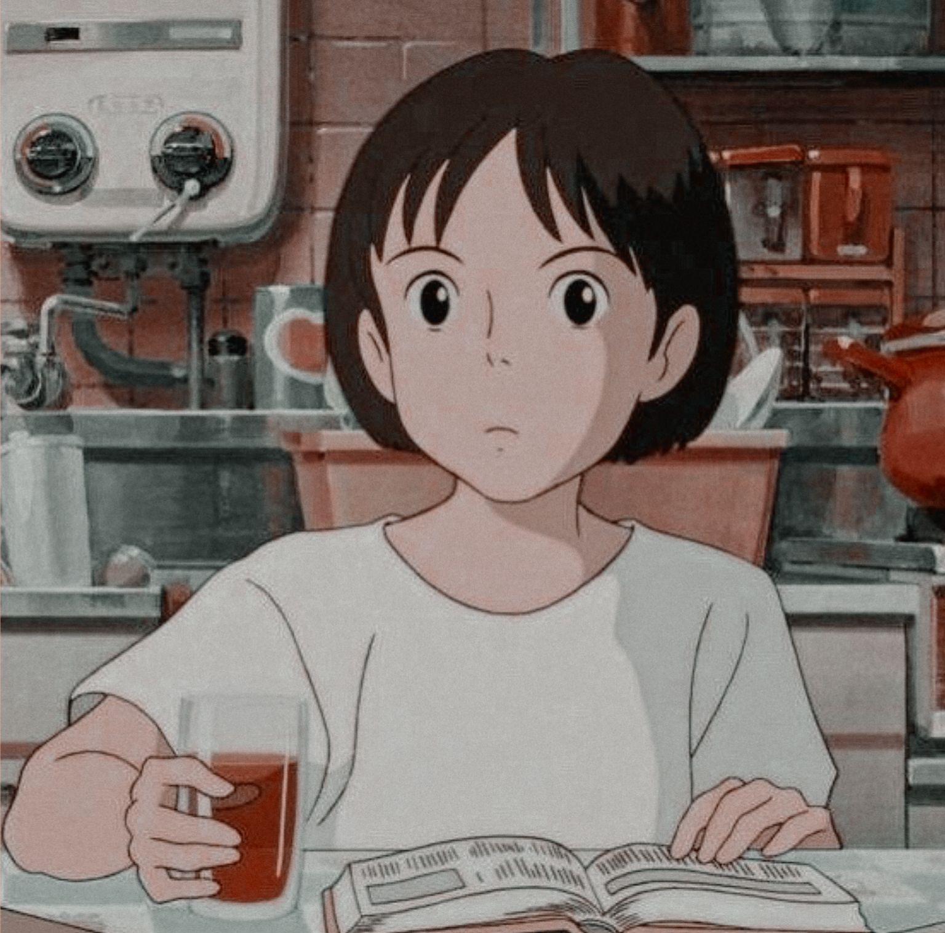
What is a book?
Buzinga!
here is our definition of the book
Any word written/printed form of useful/interesting information that will gives you knowledge or space to think.

Slide 4
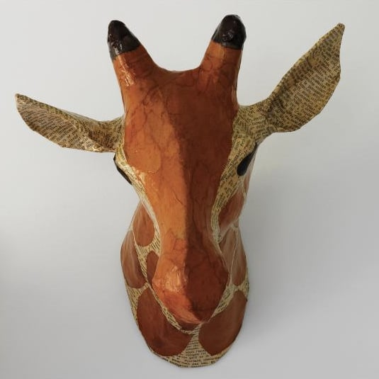
The reliability of the result
The reliability of the survey is a tiny tiny tiny bit low. In the survey, it did not give a definition of book, (unlike our amazing statistic report). This means that students might ask: “does audio books count as book?” “What about manga’s/comics?” or “My grandma bought a smartphone with an user manual, does that means my grandma read more books than me?” the length of the book is also unclear, 40 pages and 1000 page is also a book. But a 1000 pages book is 25 times longer than a 1000 pages book. Even though the definition of ‘book’ has been a bit confusing in the survey, the survey itself still gives useful information.

Slide 5
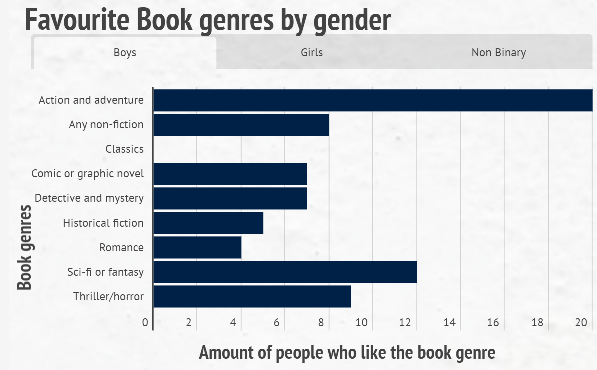
Categorical data
The graph on the left is a bar graph which shows us the favourite book genre by gender. In the boys section the absolute favourite is action and adventure followed by Sci-fi or fantasy, while classics are unread and disliked by boys.

Slide 6
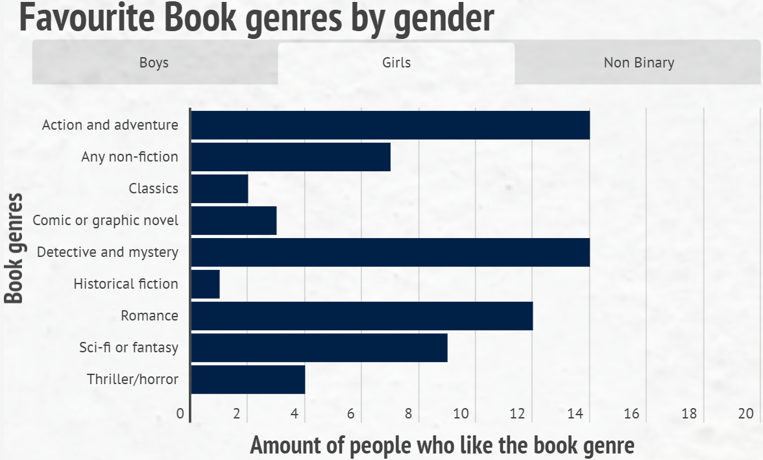
Categorical data
In the girls section action and adventure, and detective and mystery are drawed and are the favourite book choice closely followed by romance.

Slide 7
Categorical data
It is interesting to note that classics are disliked but not as disliked as historical fiction. in the non-binary section action and adventure is liked. There are some genres where it is much more popular in one gender than the other gender. For example, there is much more girls like ‘romance’ than boys. Meanwhile there is much more boys like ‘thriller and horror’ than girls. although further research is to be conducted into why the results are like this we can assume that it is this way because year 9’s are young and like action and adventure especially in noys while girls prefer romance and detective and mystery.

Slide 8
Amounts of books read and their genre (graph)

Slide 9
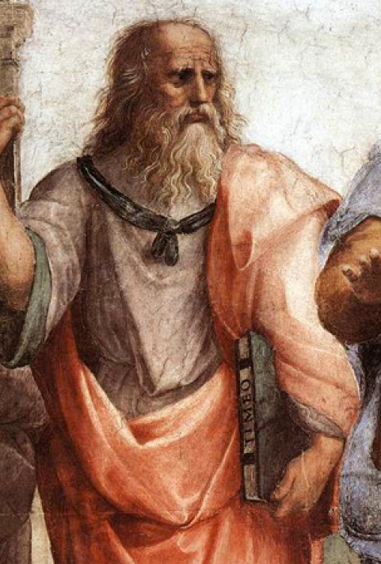
Amount of books read and their genre (explanation)
This box and whisker plot, above, shows the amount of books read by year 9's and their different genres. From the data we are given all book genres are read much the same by year 9's. Excluding classics (as there are only two results) the medians are quite similar (9, 4, 102, 3.5, 5.5, 7.5, 5, 12, 5 in respective order) The modes are a bit different (10, 2, N/A, 2, 5, 5, 10, 10, 1 in respective orders) and the mean are also quite similar (13.02, 12.27, 102, 4.5, 41.81, 7.83, 8.31, 16.95, 12.23 in respective orders) Notice there is no mean, median or mode above 17 (excluding classics).

Slide 10
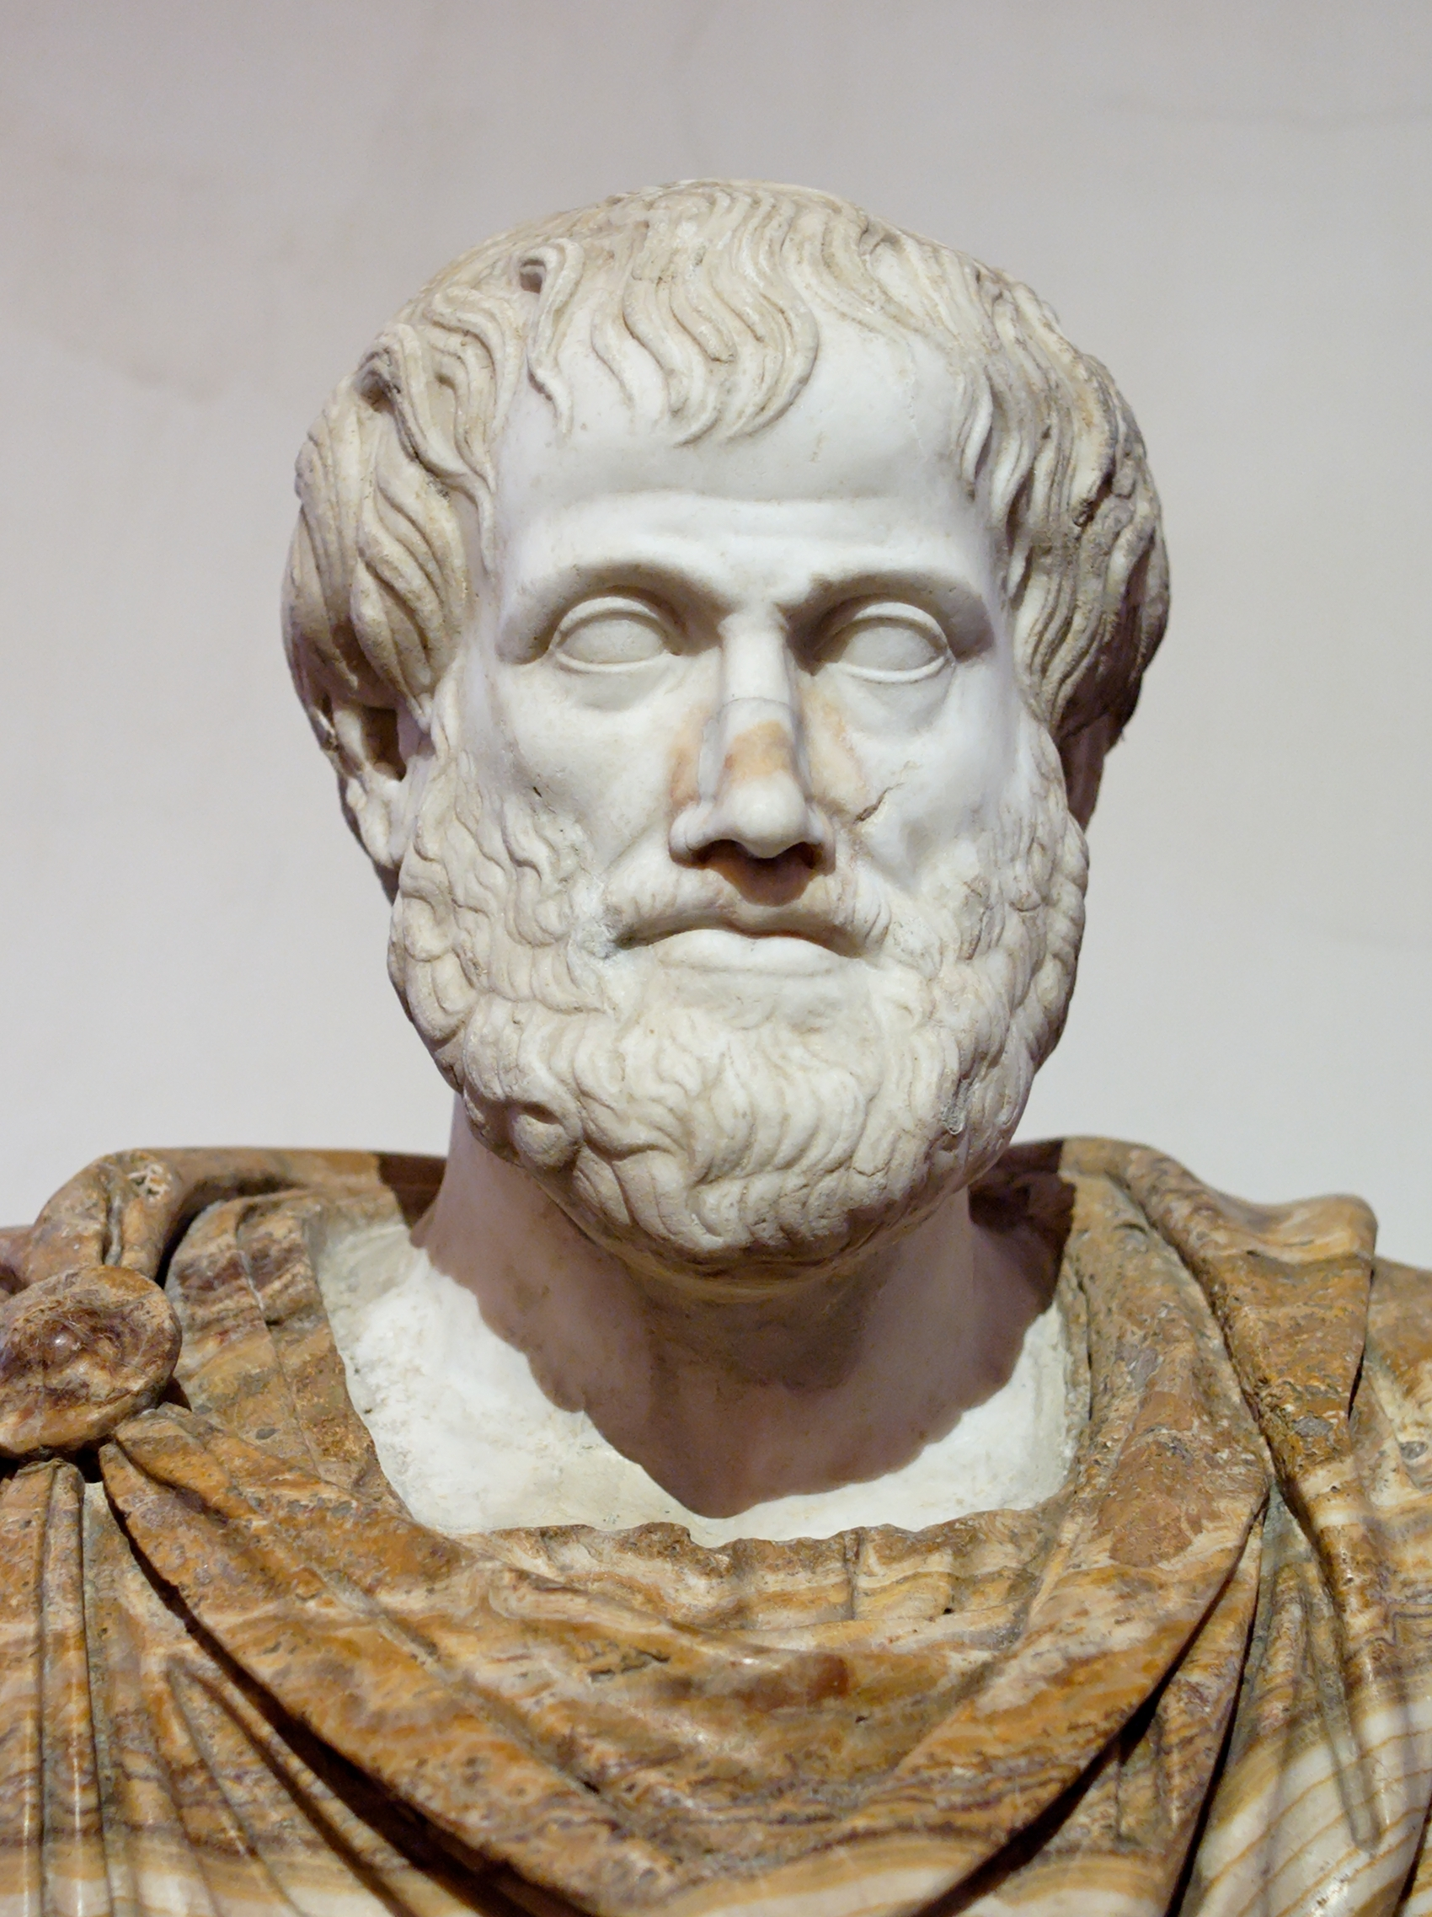
Amount of books read and their genre (explanation)
This shows us there is no general most read book genre. However, there are large outlier's in detective and mystery (100, 250, 365) this shows us that this genre is very liked and read by those three people it also has a much higher 3rd quartile maximum value further proving this. All the other outliers are below 100 and most hover around 50 . There are quite a few outliers and is interesting to note that the majority of them are below eighty less than twice the maximum 3rd quartile range. This data may be like this because many people are more into video games therefore they read an average of 10 or below books and the people who don't play video games read more therefore making outliers higher.

Slide 11
The graph on the left shows us the amount of books read by different genders this graph shows us that Non-Binary has the 'highest' average maximum and mode far exceeding the other gender however Non-Binary had only 3 results making the data in the graph 'unreliable'. Male and female both had the same minimum and both had their second quartile maximum's below 40. Both of their medians, 1st quartile ranges and 3rd quartile ranges were about the same while the girls had higher maximums for their 3rd quartile range (around the 30 mark) the quartile's for boys were Q1 2, Q3 12.25 IQR 10.5, while for girls it was Q1 3, Q3 15, IQR 12 for no binary didn't have any 'whiskers' however it's quartiles were Q1 11.5, Q3 192.5 and IQR 181 this is very high however there was only 3 results which skewed the data in this way. Both the girls and boys had the same mode of 2 while their means were much different with girls being 20.7 and boys being 11.

Slide 12
For non-binary their mean was very high being 129.3 however there was not enough data to calculate the mode. The range of the boys was 25 and the girls had a range of 30. Non- binary had a huge range of 362 This data is positively skewed and has a very step decline. It is interesting to note that the girls had extremely high outliers 250, 200 and 100 while the boys outliers didn't exceed the 60 mark however they are much more consistent and closely plotted then the girls outliers. More research will need to be conducted to investigate the reason for this data shape however it might be because boys like to play video games and girls don't therefore they read more books.

Slide 13
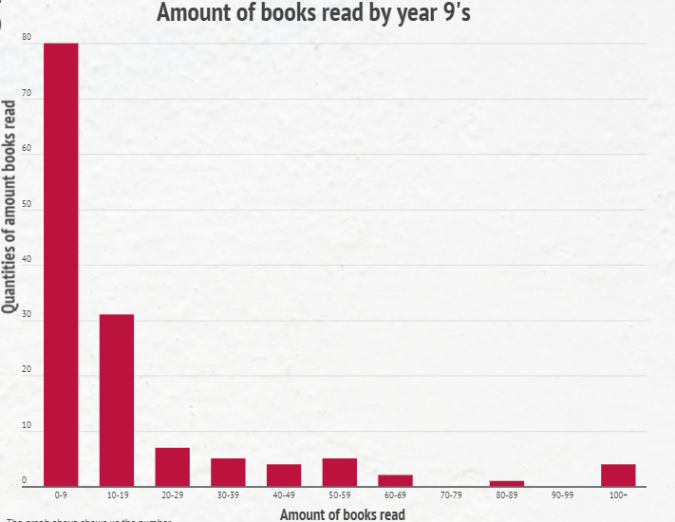
The graph on the right shows us the number of books read by year 9's. most of the data hovers around the left side or the 0-9 column. Interestingly the median and the mode (4 and 5) are less then half that of the mean (13.9) showing us that the mean is skewed because of the high data values in the left side (0-9 column) of the graph). The quartiles for this data set are Q1 4, IQR 3, Q3 this leads us onto the next topic, this data is positively skewed showing us many year 9's don't read a lot of books.

Slide 14
there are no real outliers however it is interesting to note that more year 9's read 100+ books than the 3 other left hand columns. There is more research needed to be conducted in order to show us why the data goes 'looks' like this. However I believe that it is because many younger students such as year 9's dislike books as they probably prefer video game

Slide 15
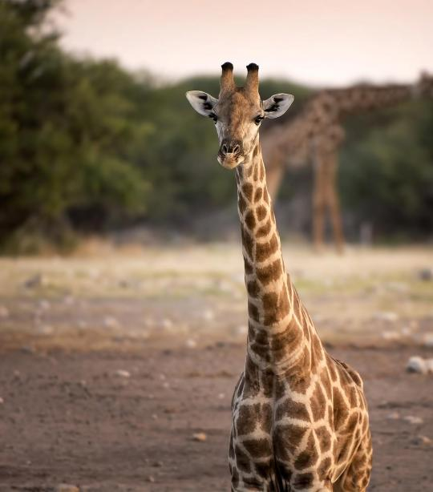
Conclusion
In conclusion, from the ‘favourite book by genre’ data, we have found out that girls and boys have different tastes in different book genres. From ‘amount of book genres read by their genre’, the data shows there is not an absolute favourite book genre read by year 9 students in All Saints’ college year 9. From the ‘amount of book read by different genders’, the result shows that the amount of books read by girl has a higher mean and mode compare to boys (probably because boy plays too much video games). Lastly, in the amount of book read by year 9, the static shows that read 0-9 books per year are the most common option to year 9 students in All Saints College.

Slide 16
Conclusion
The result of our research can help book writers, sellers and libraries however it only represents high paying, high education students of one particular school meaning that this data cannot be used for the wider population of year 9's across Australia. However, his data can help libraries, book stores and book writers by allowing them to write and sell books to people and know that they relate to the likings and 'size' of the book to help stop and restrict an ever-growing problem of younger generations playing too many video games.

